Slide 1

Deep learning classification
Module: C3
Group: 7
Students: Cristian Gutiérrez
Iñaki Lacunza
Marco Cordón

Slide 2
Index
Bag of Visual Words (BoVW)
Deep learning Classification (MLP)
Fine-Tuning NasNetMobile
CNN from scratch
Data Augmentation (Well Done)
LR Scheduler / Weight Decay
Reducing Parameters
Improving Learning Curve
Changing Model Architecture: Different Paths
Conclusions

Slide 3
Week 1
Bag of Visual Words (BoVW)

Slide 4
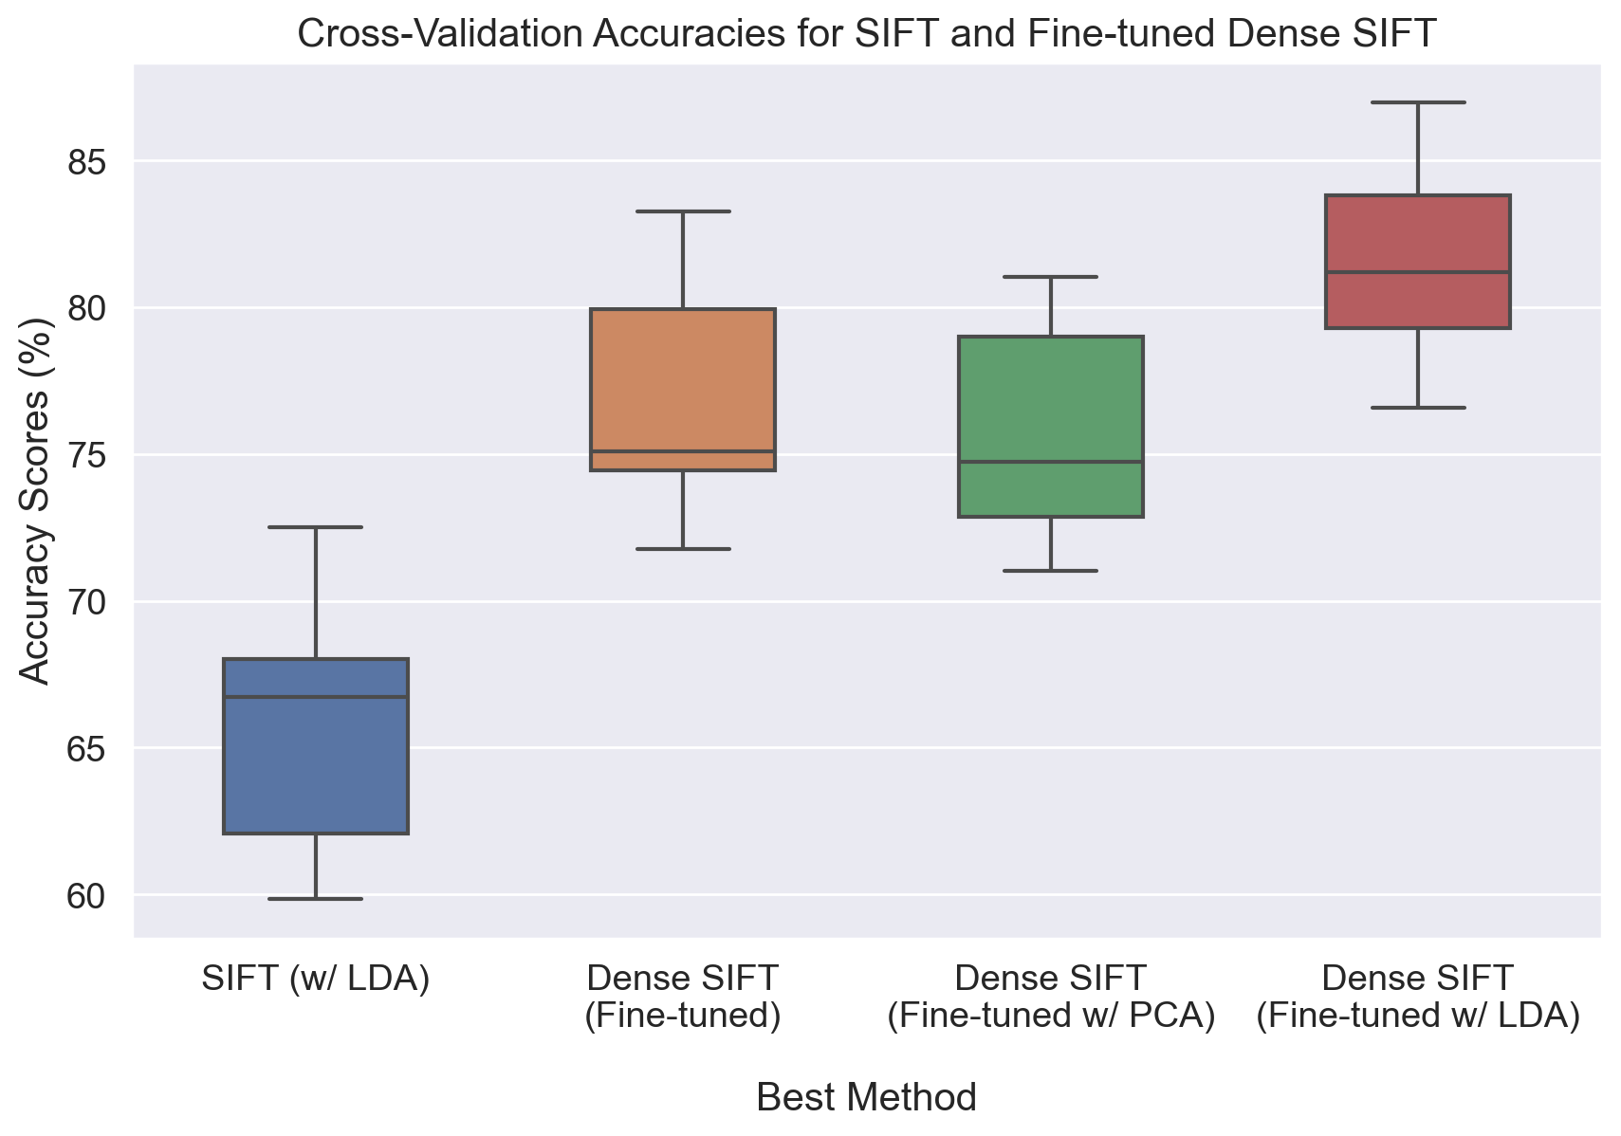
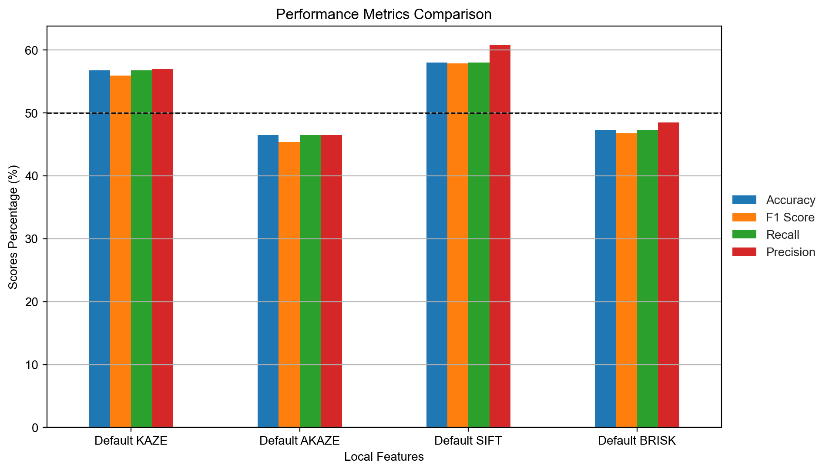
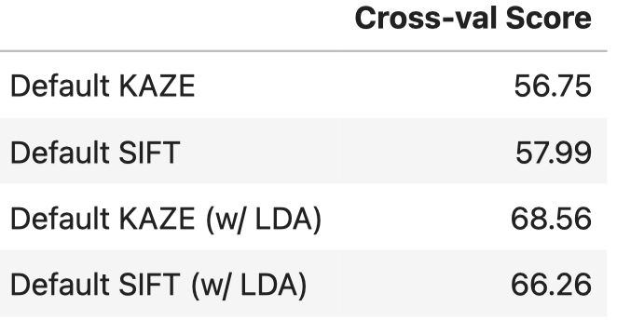

Feature Descriptors
Local Descriptors
Dense SIFT
n_Features = 185
n_OctaveLayers = 2
step_size = 18

Slide 5
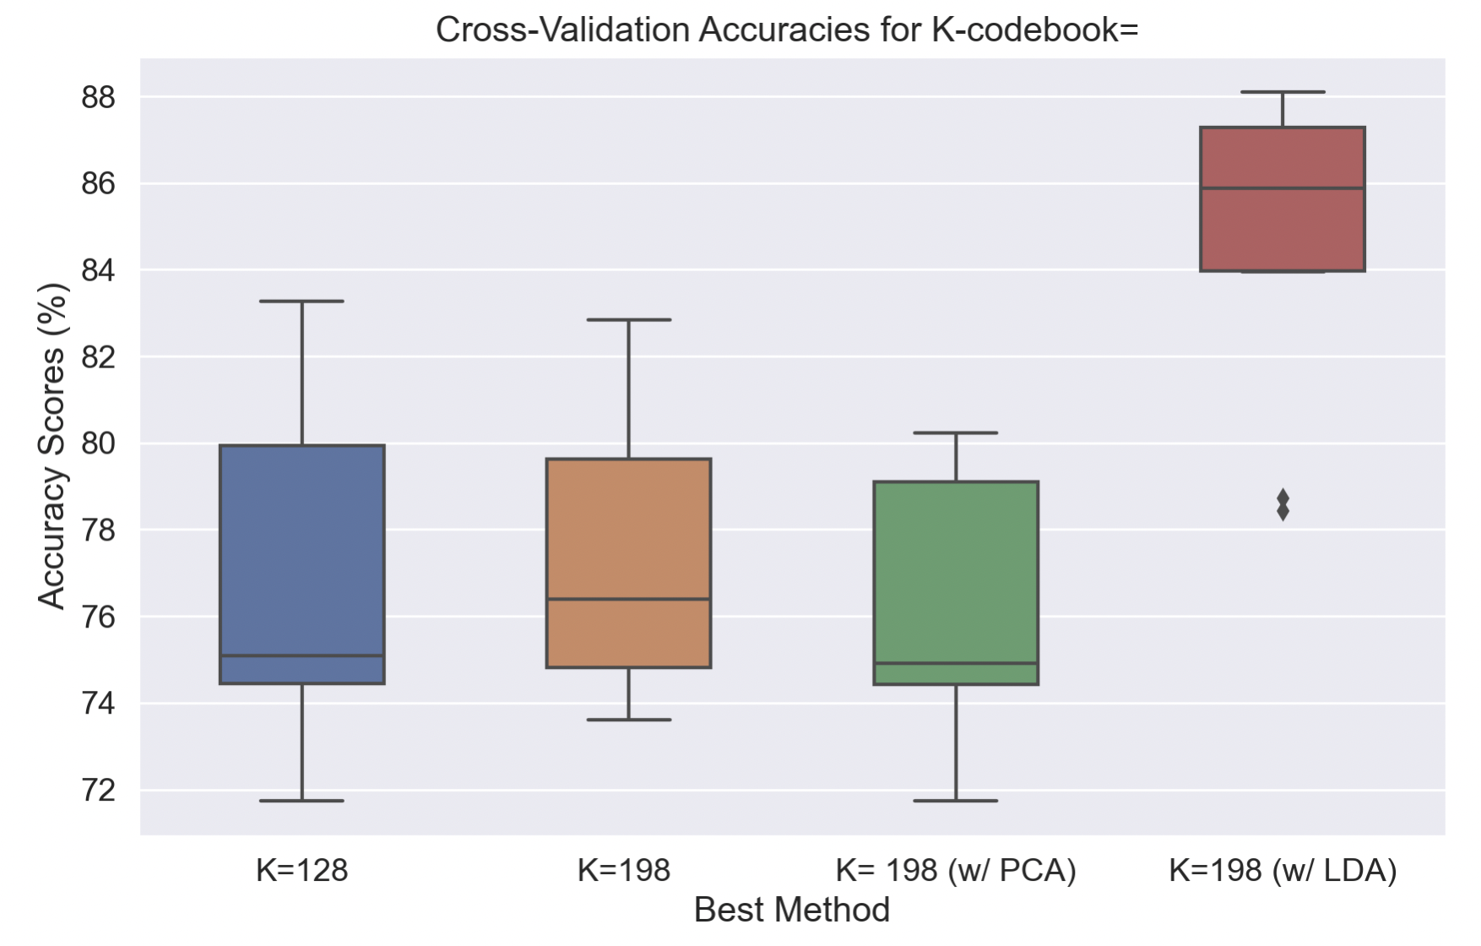
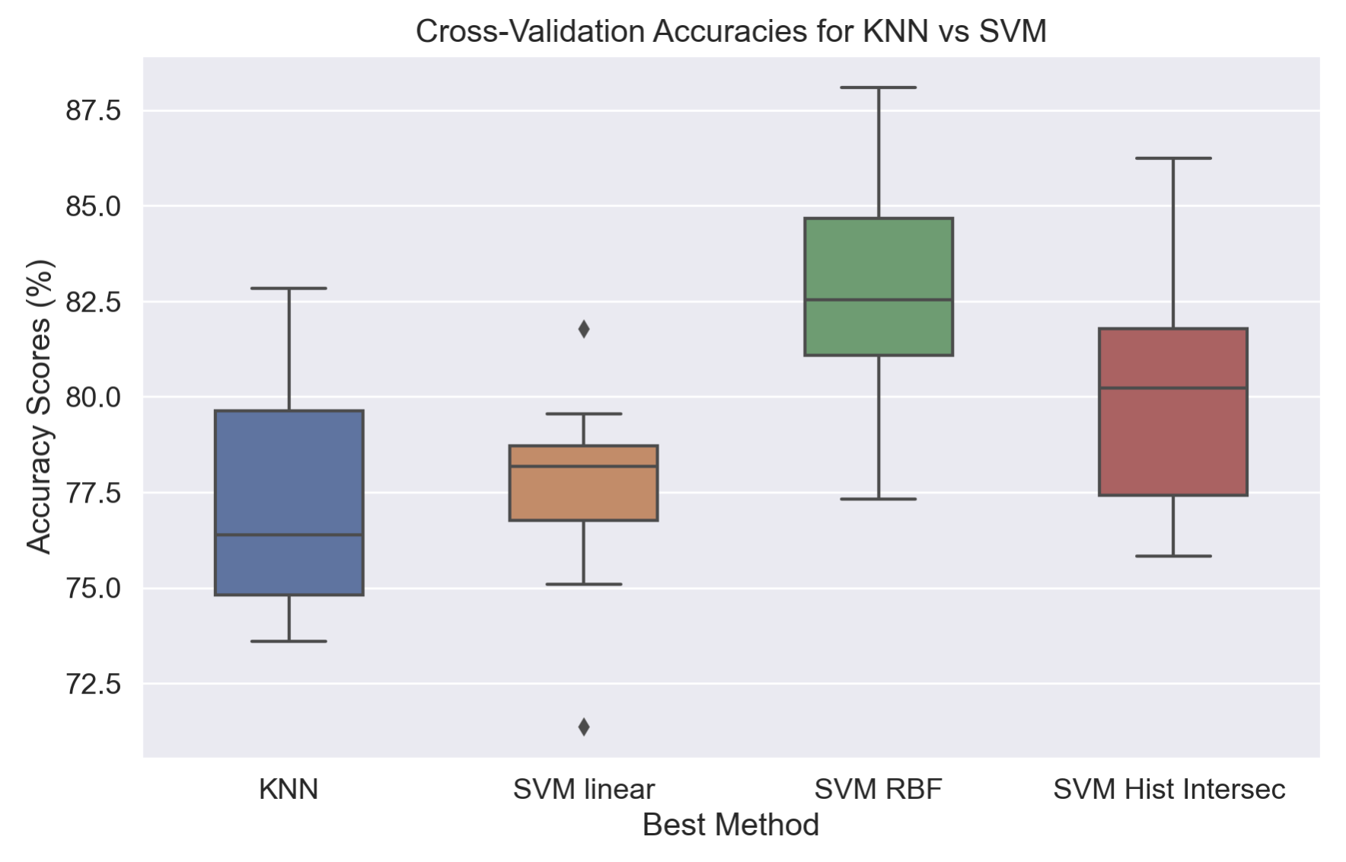
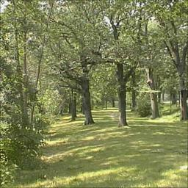
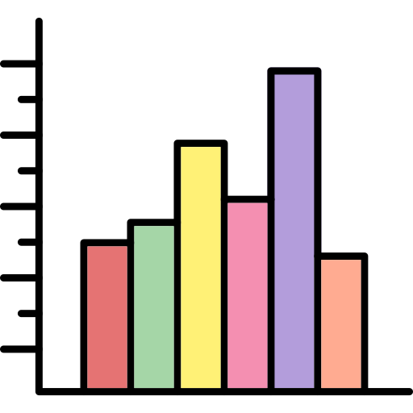
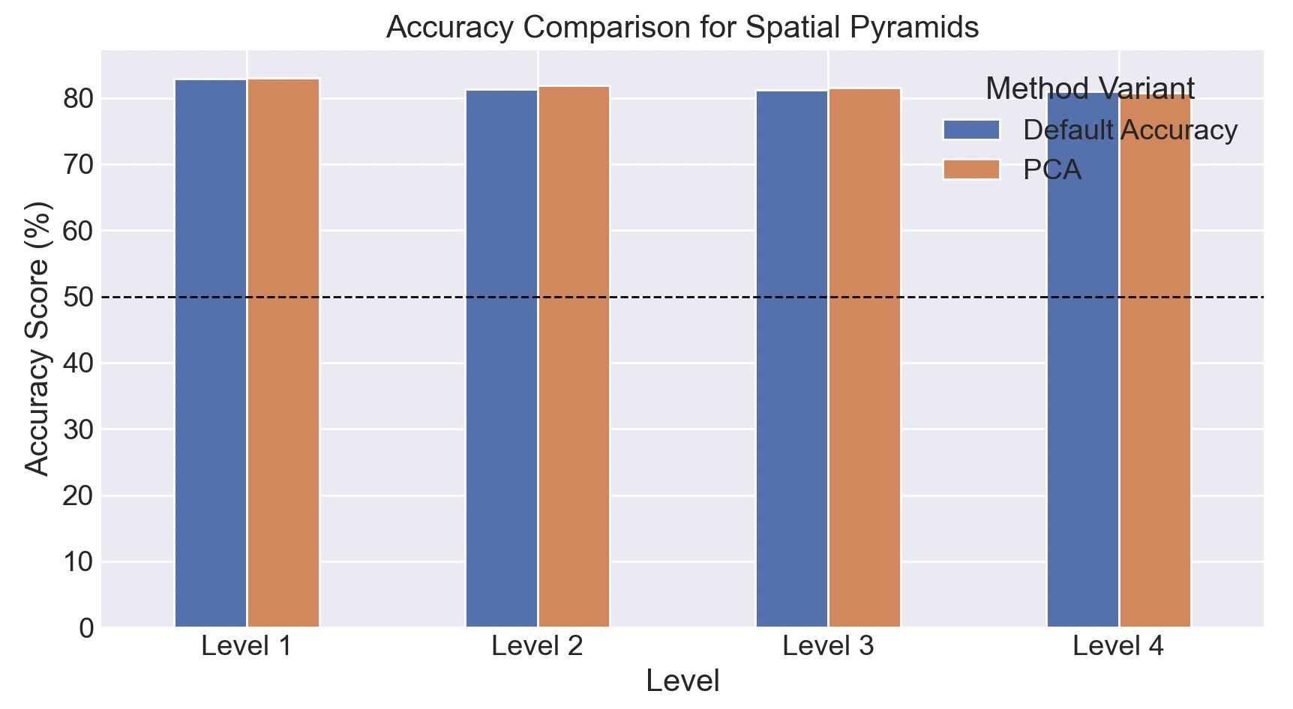
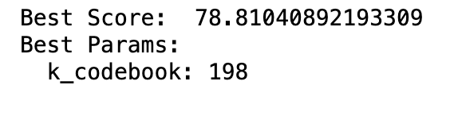
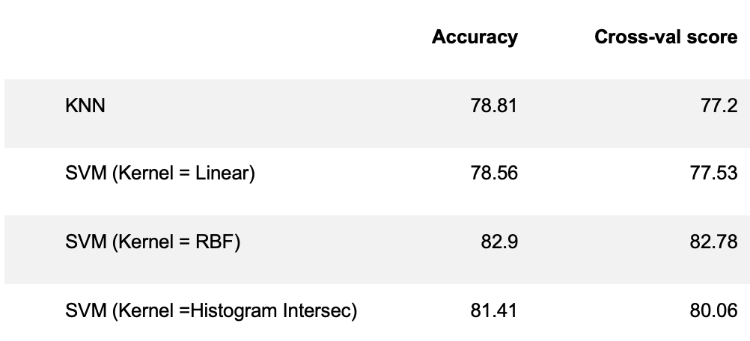
Parameter Optimization
Clustering
Classifier
Spatial Pyramids

Slide 6
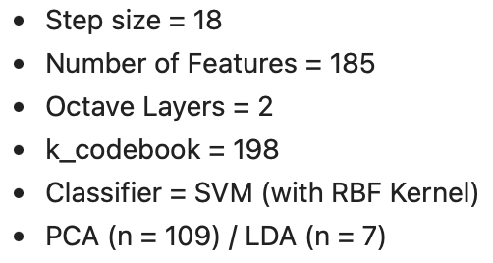
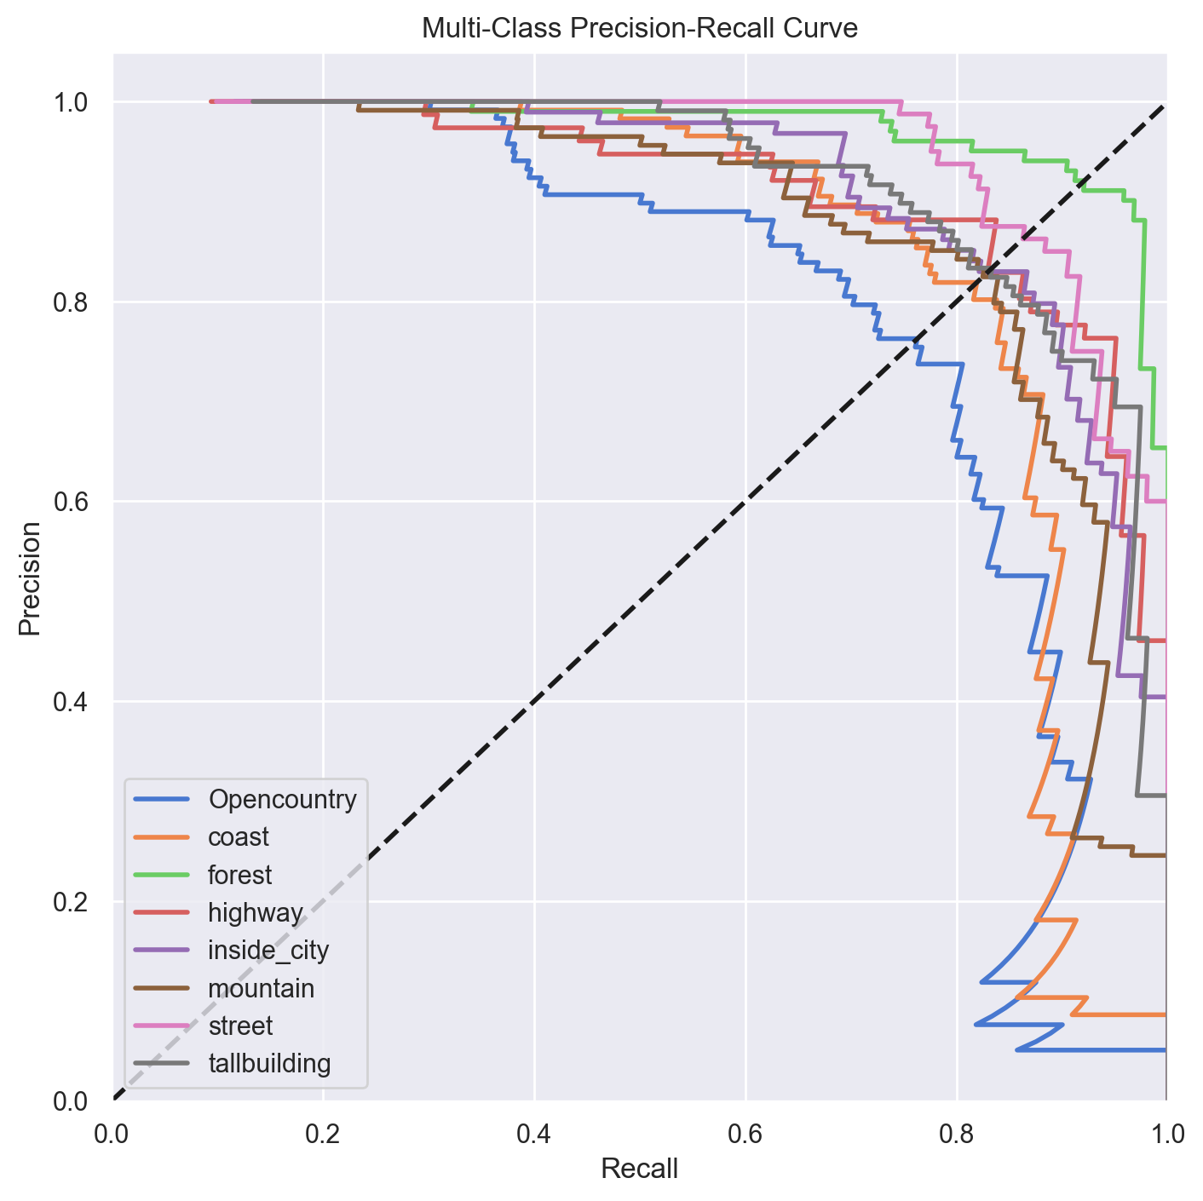
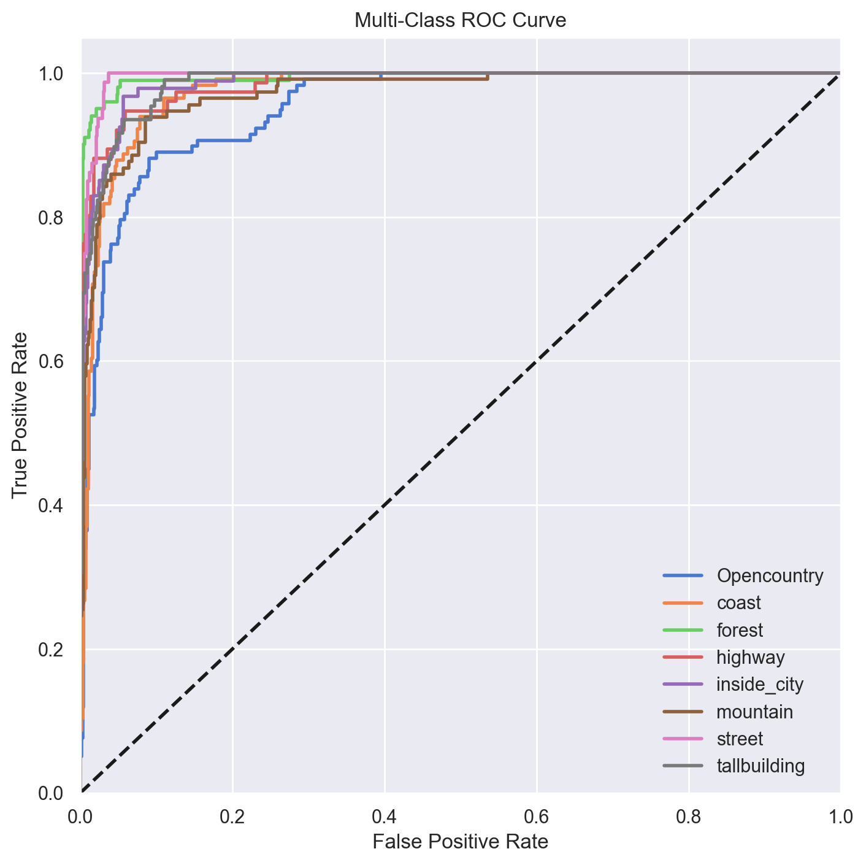
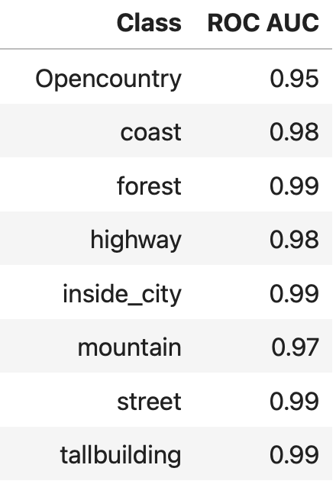
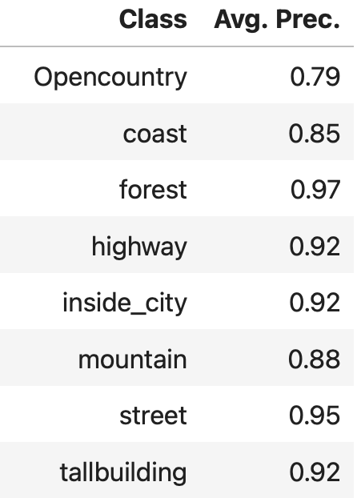
Precision-Recall Curve
ROC Curve

Slide 7
Week 2
Deep learning classification (MLP)

Slide 8
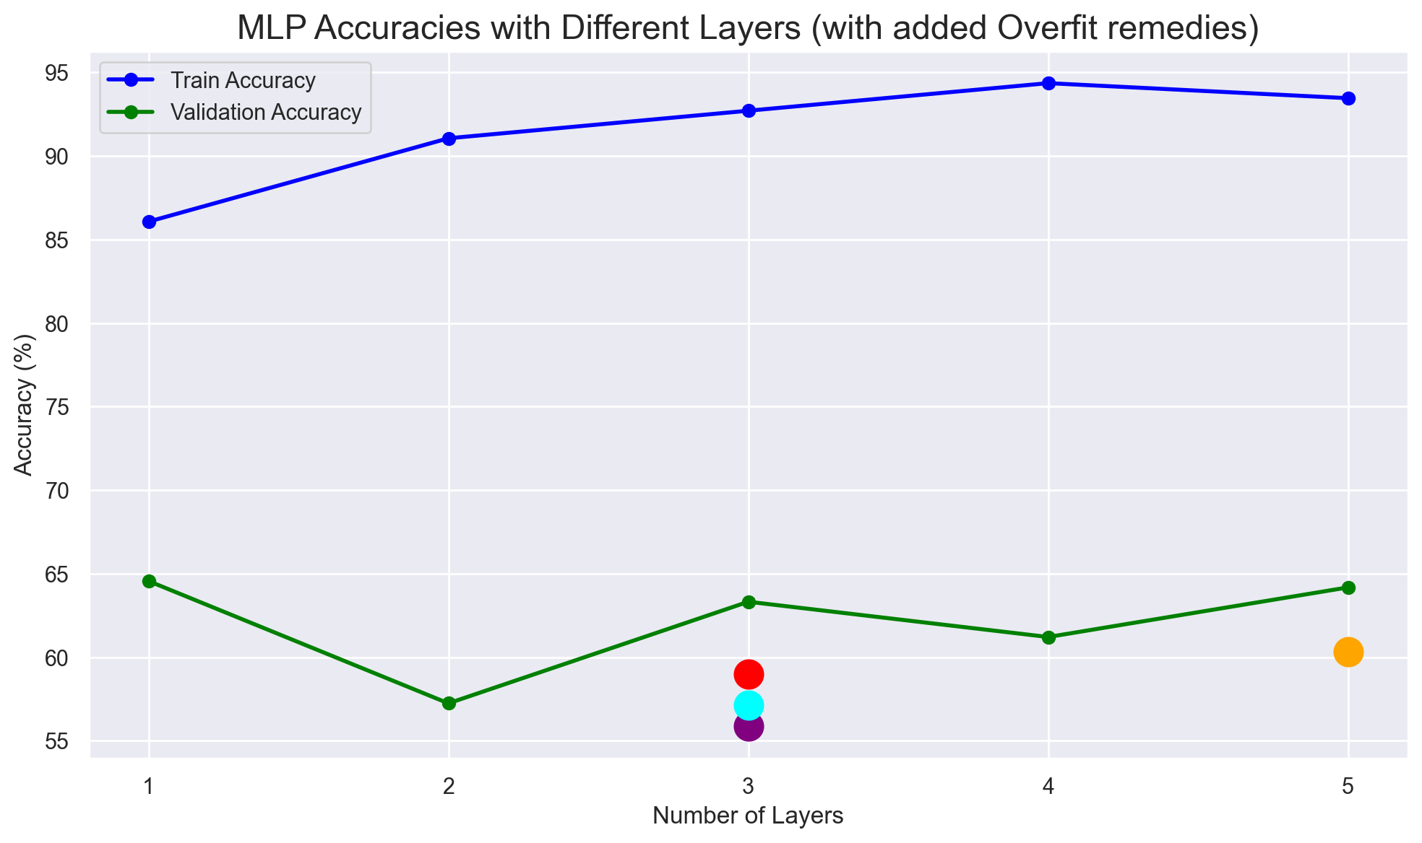
Current Situation: MLP
Overfitting remedies
We tried several independent approaches to solve this overfitting:
Increase image size to 256.
Use Adam optimizer.
Reduce the neural units.
(3 Layers, 512 -> 256 -> 128)
Add L2 regularization. (= 0.001)
Neither of the remedies seems to be solving the overfitting we have, as there is still a big gap between train and validation accuracy.

Slide 9
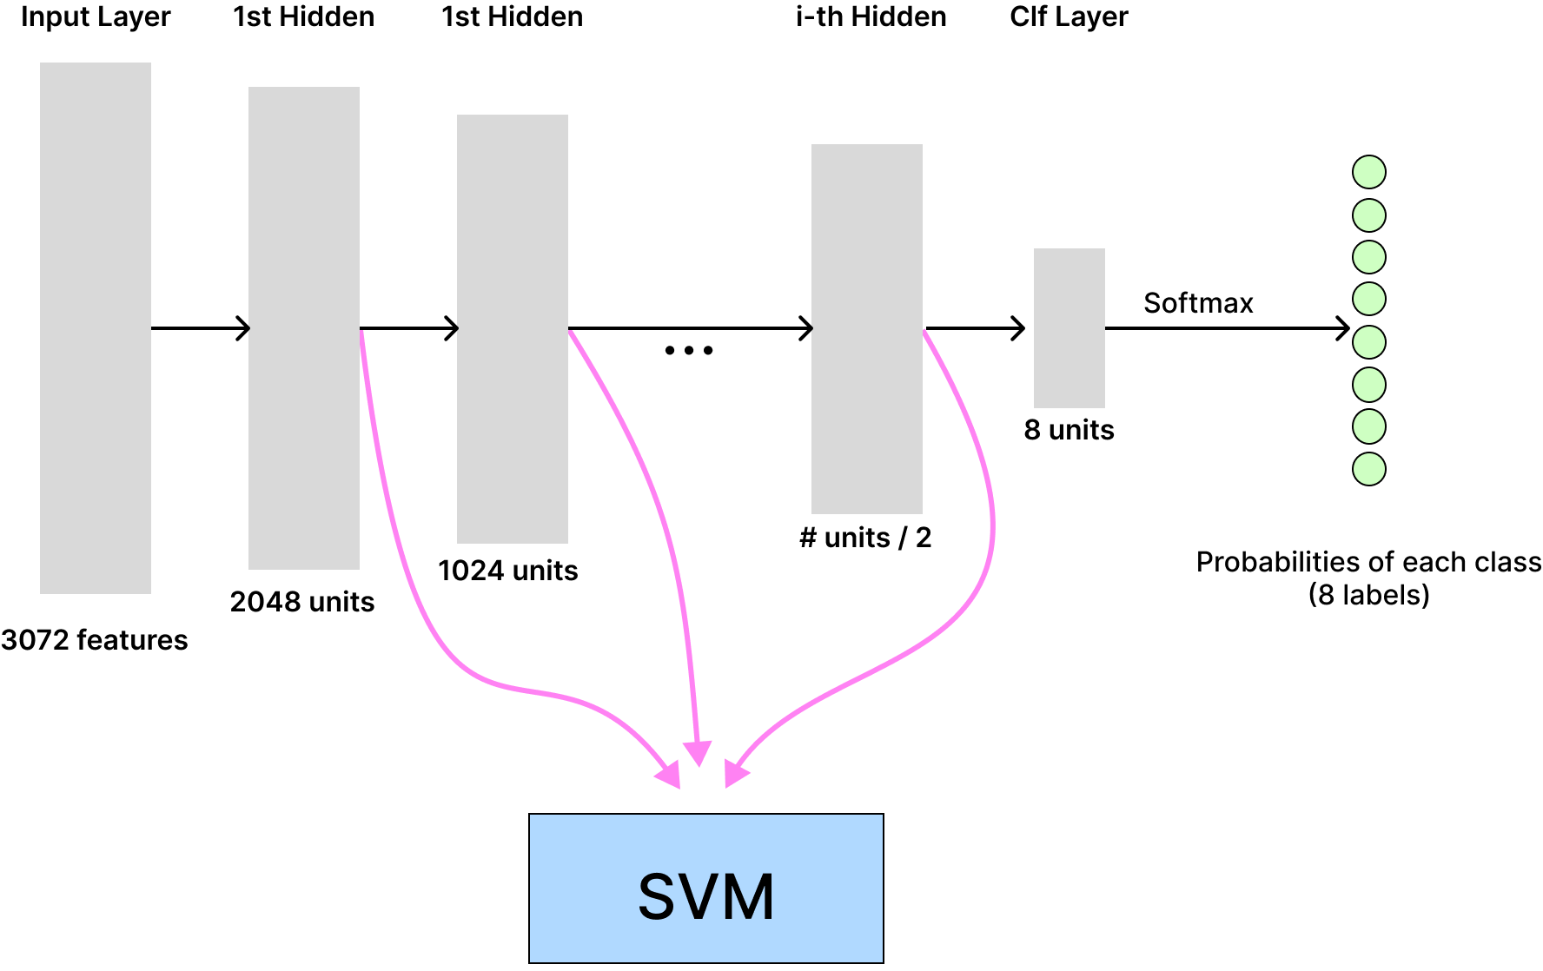
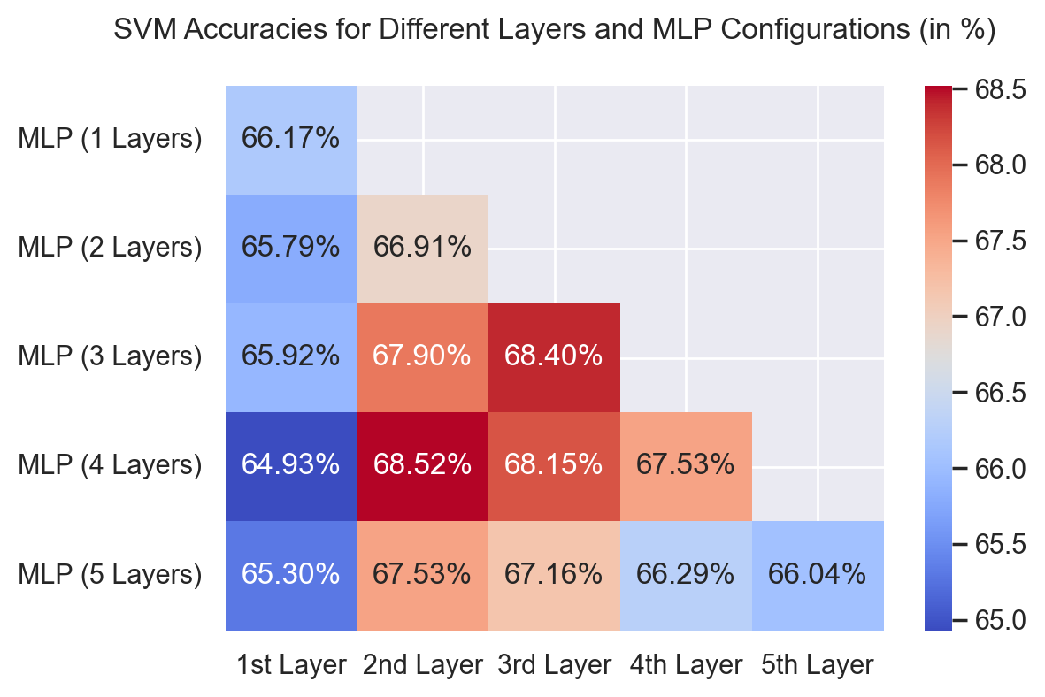
MLP Hidden Features as Input for SVM

Slide 10
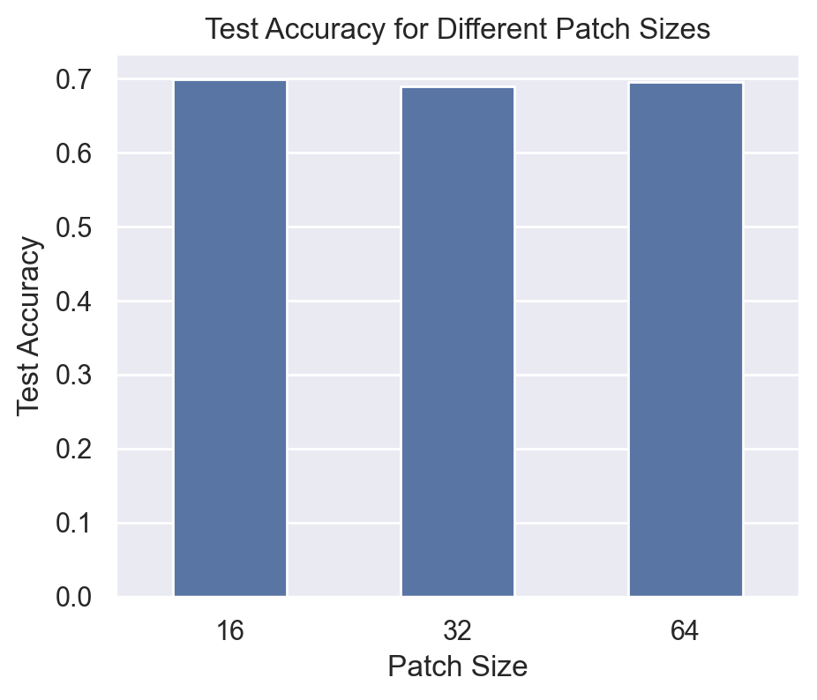
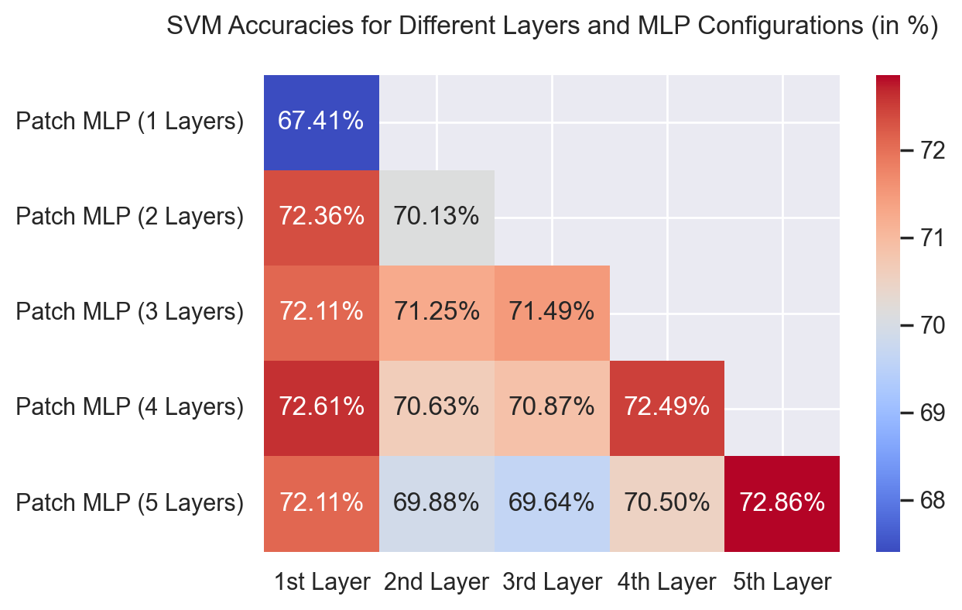
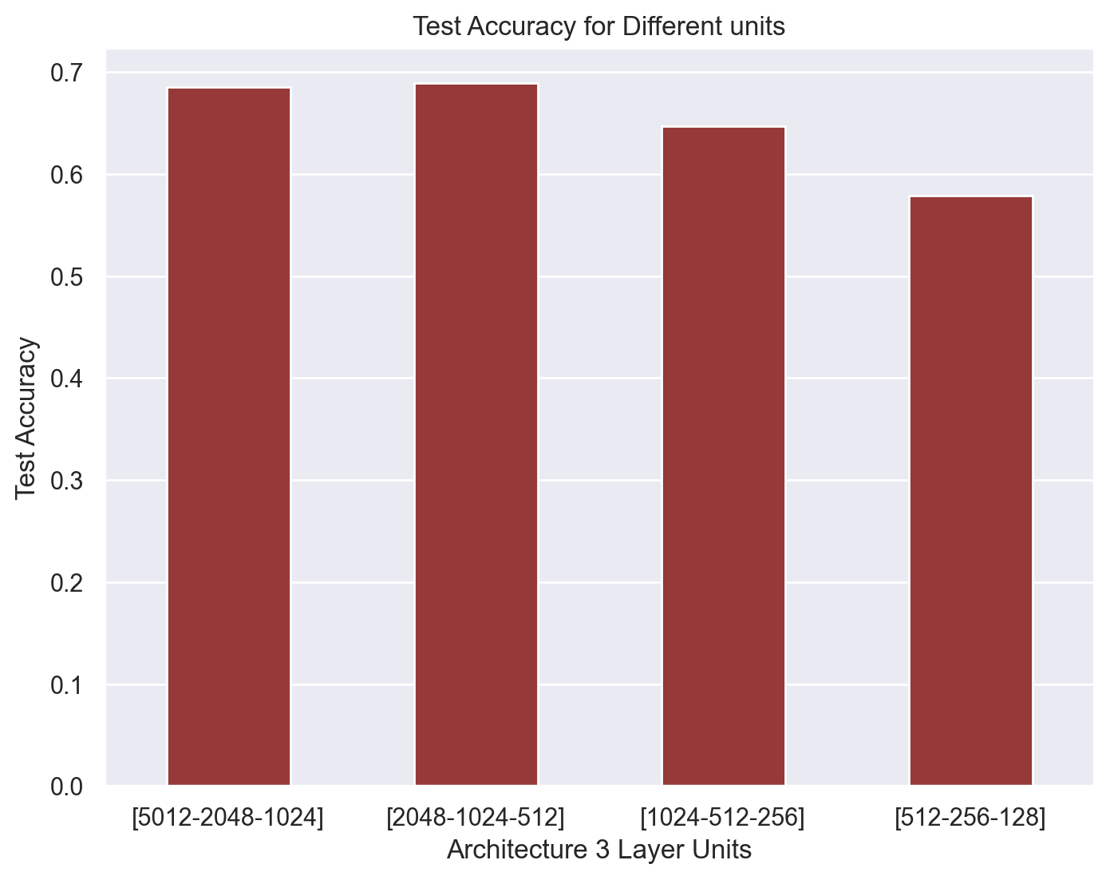
Patch Based MLP

Slide 11
Week 3: Fine-Tuning NasNetMobile

Slide 12
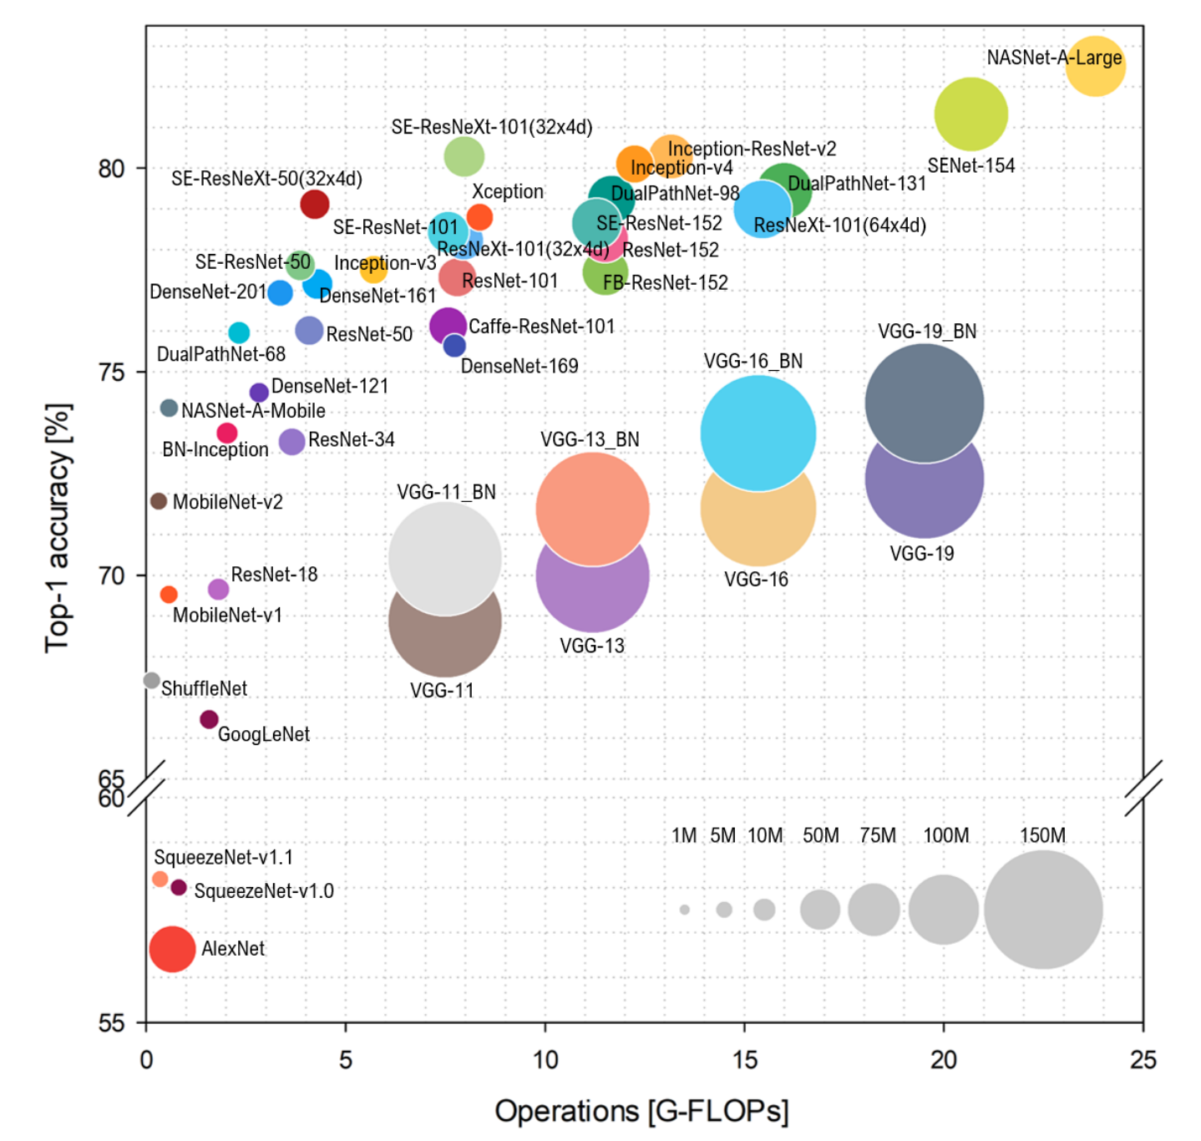
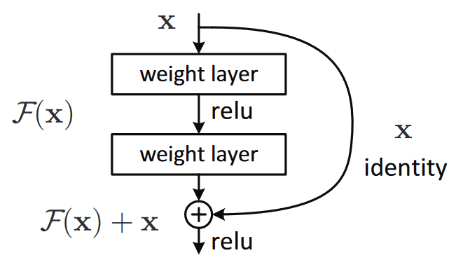
Fine-tuning NasNetMobile
Depth: 389
Parameters: 5.3M
Neural Architecture Search (NAS)

Slide 13
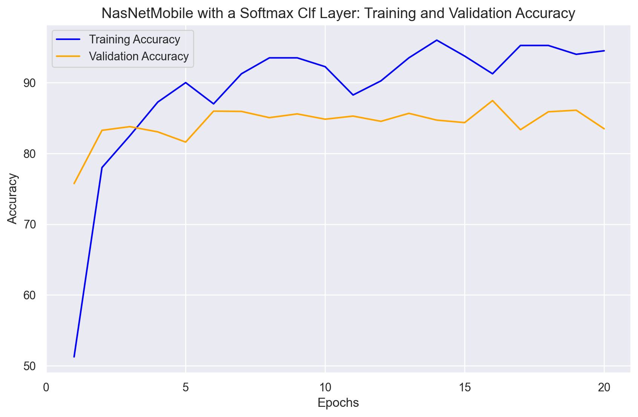
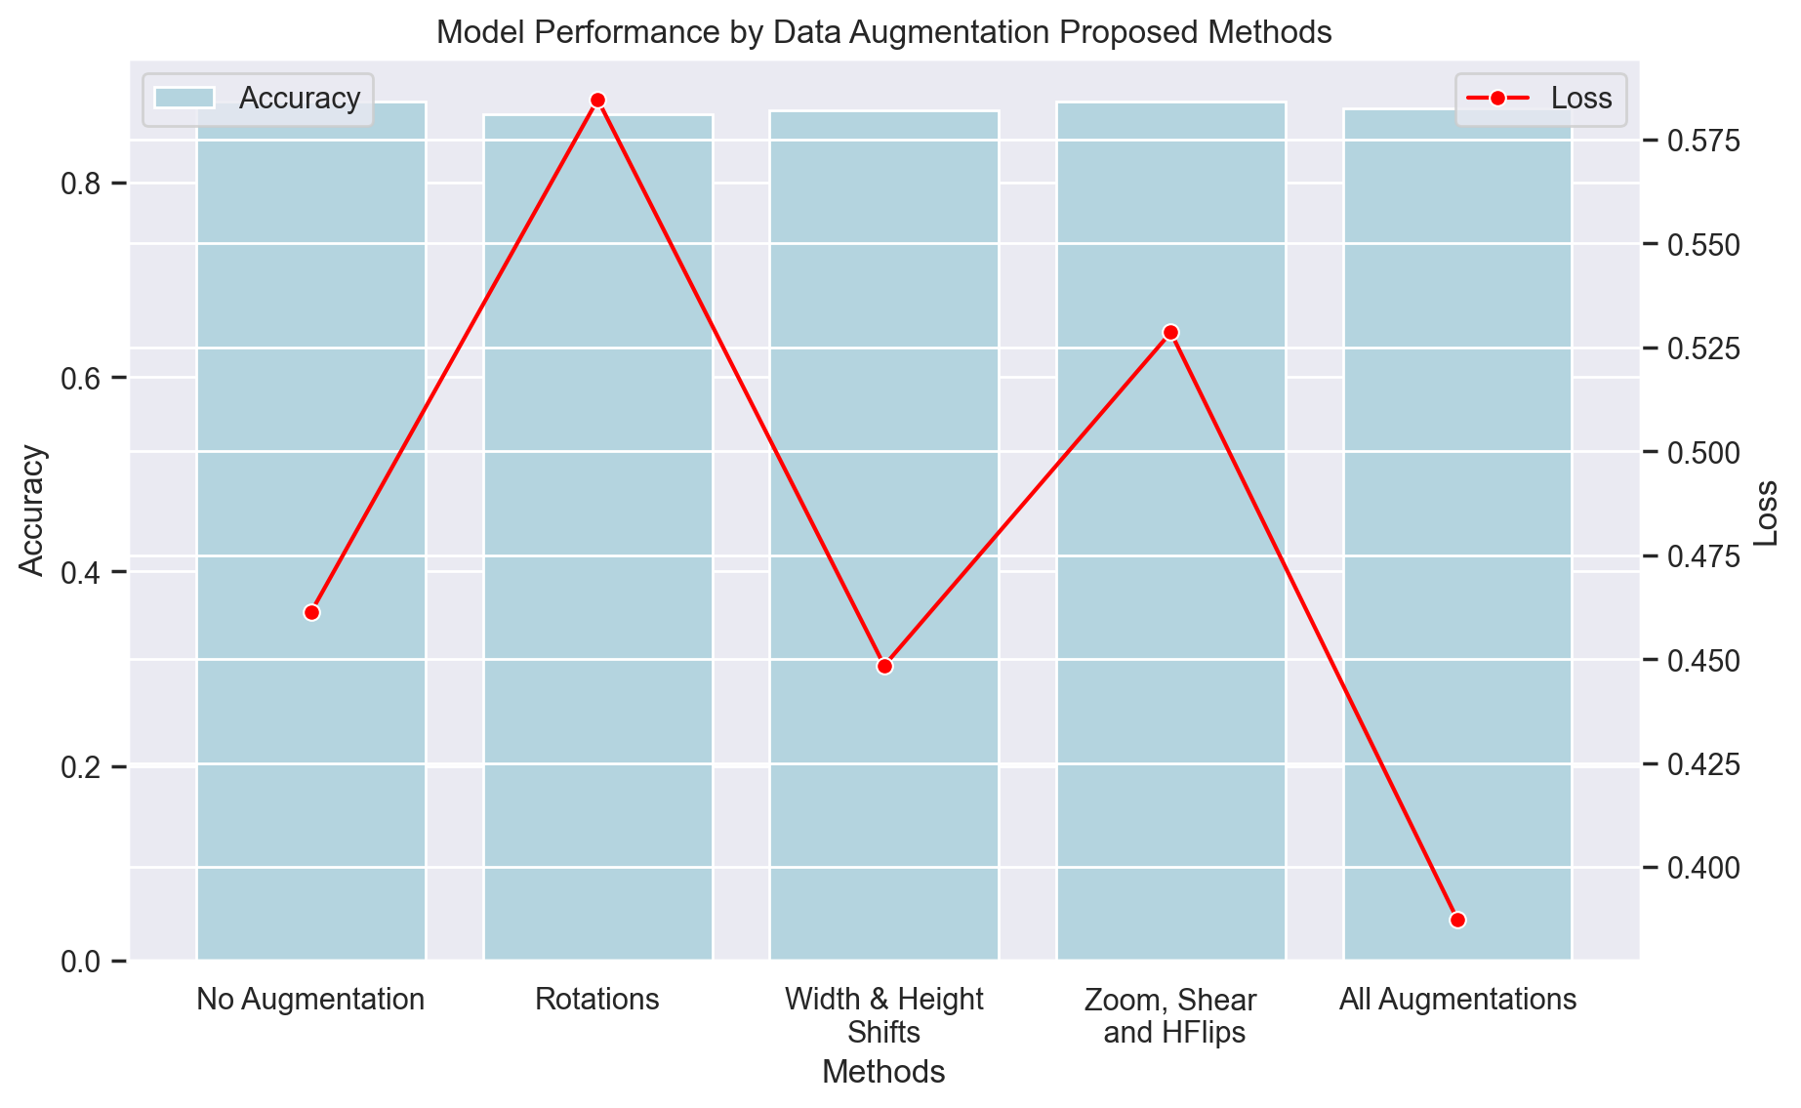
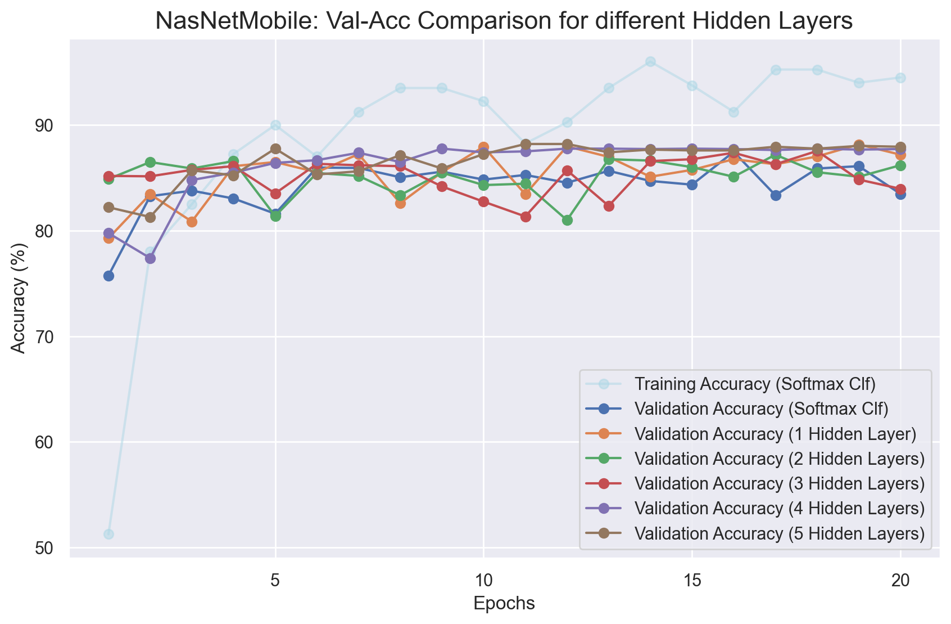
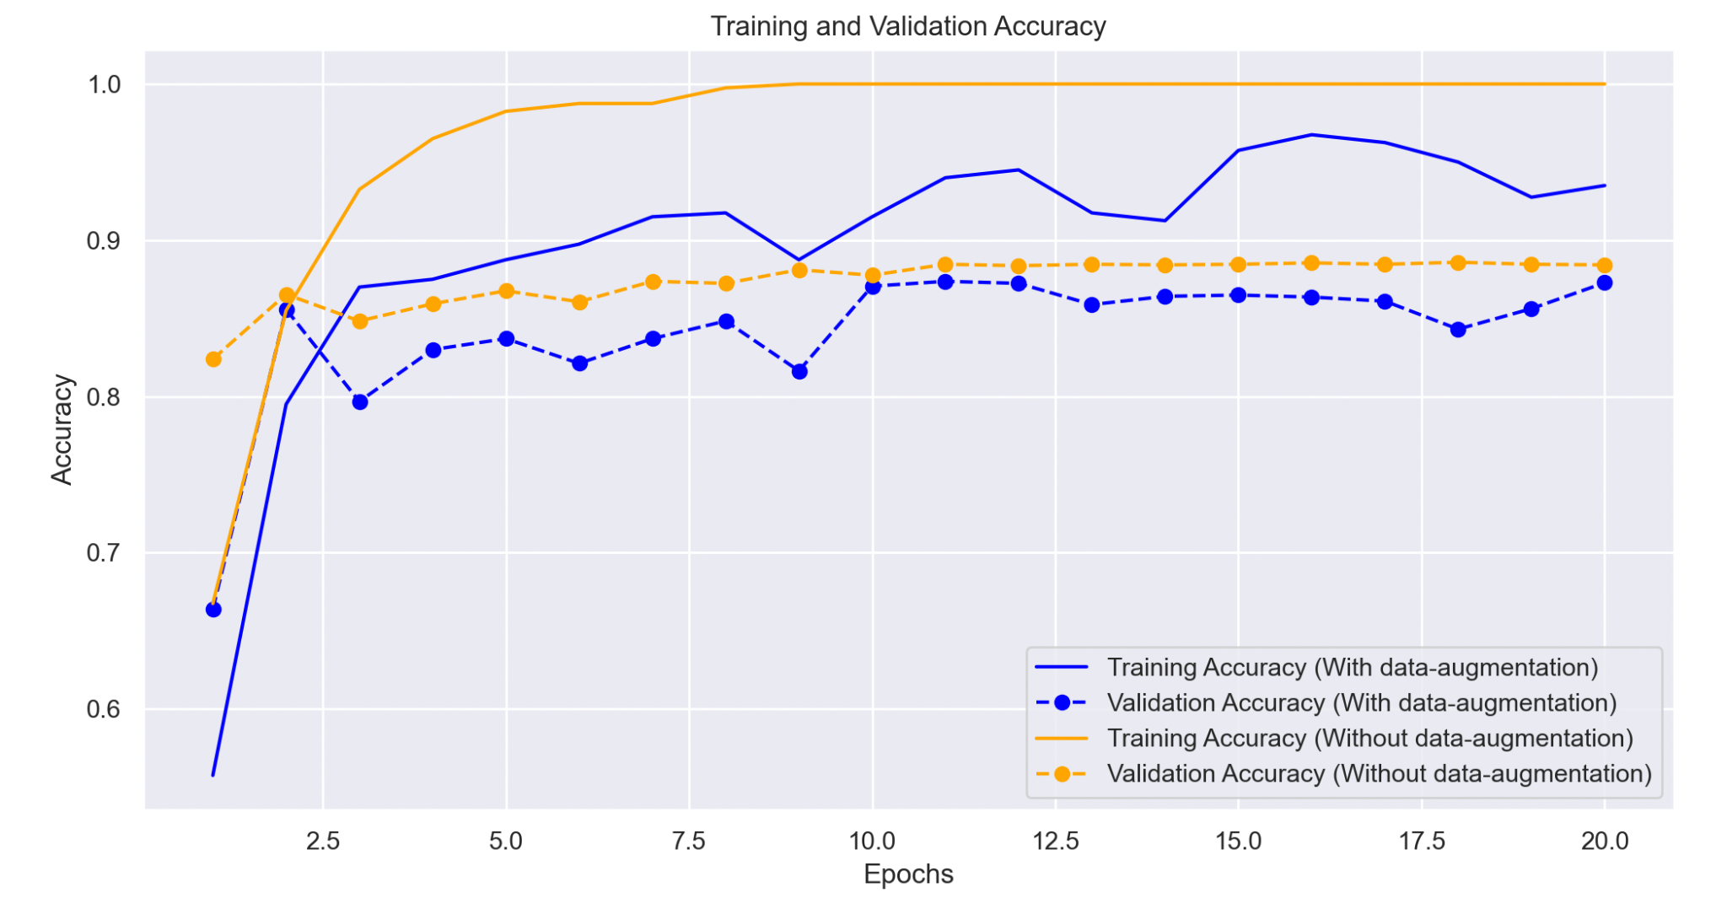
Overfitting
Data Augmentation

Slide 14
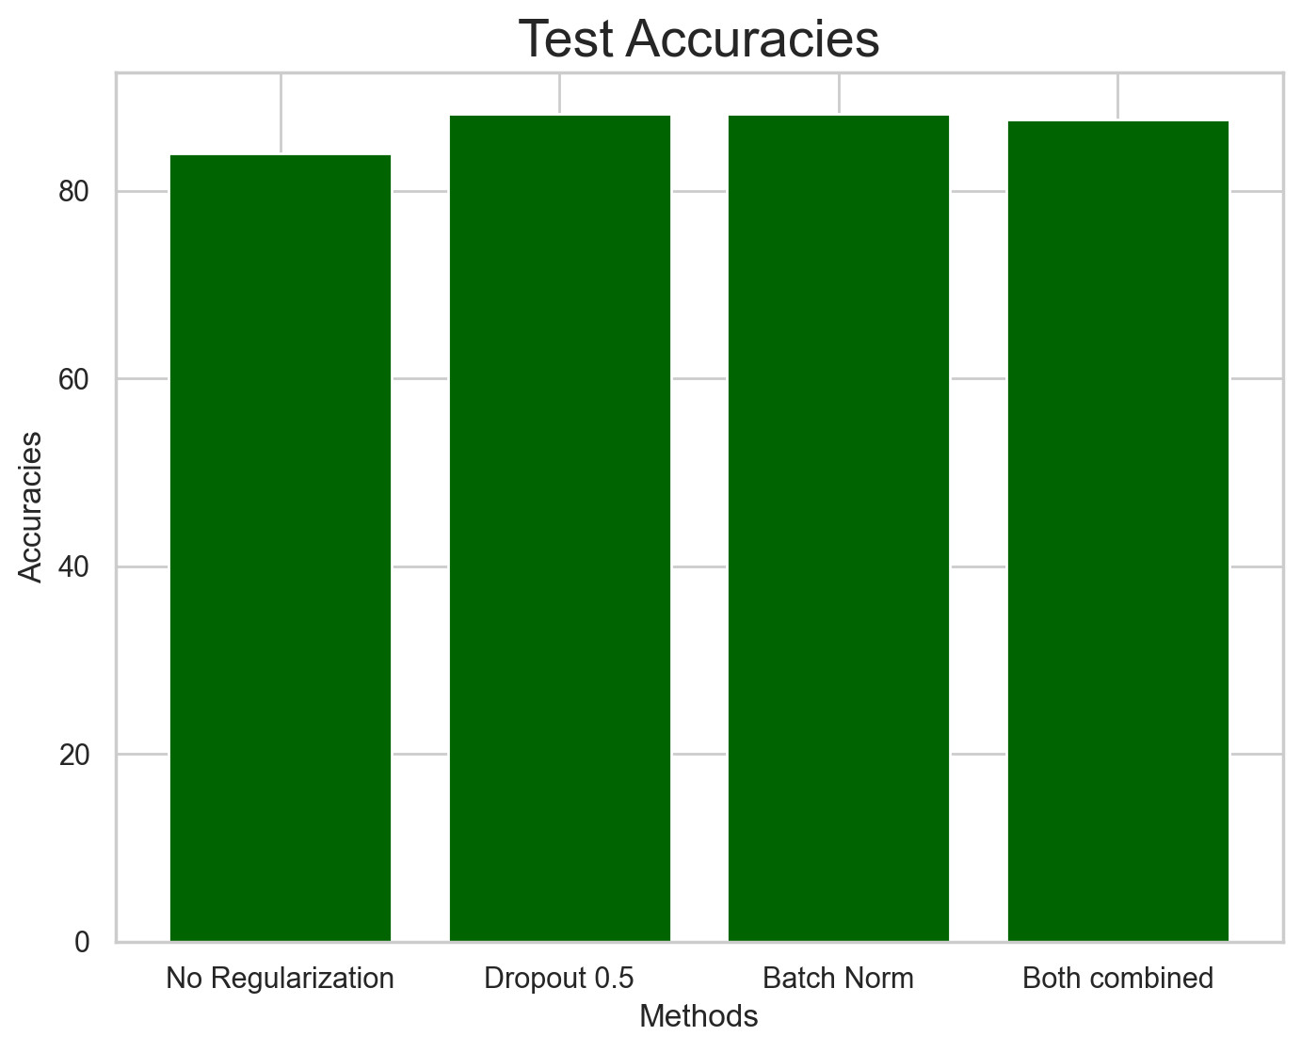
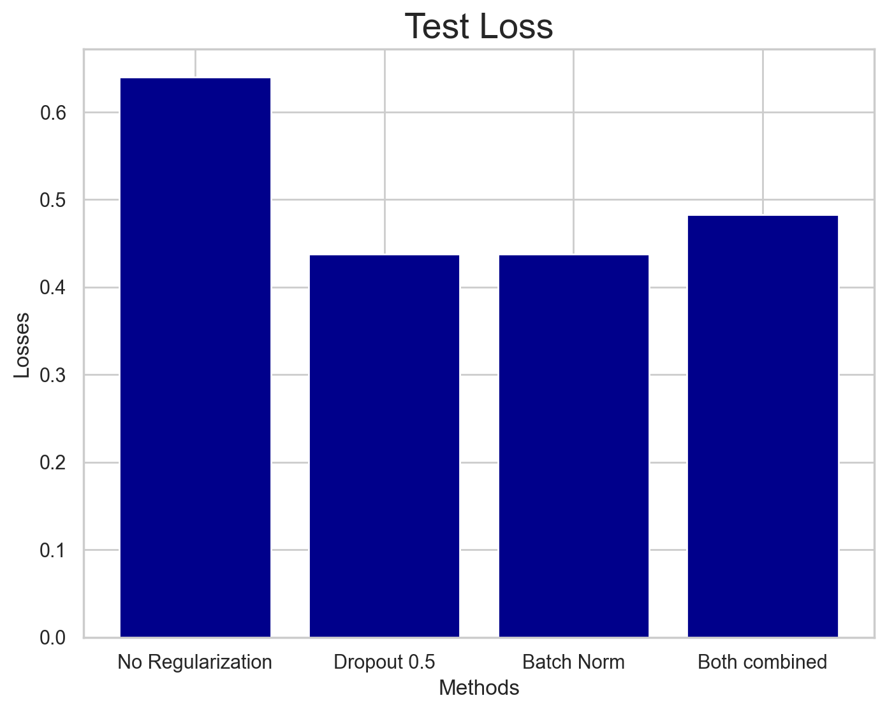
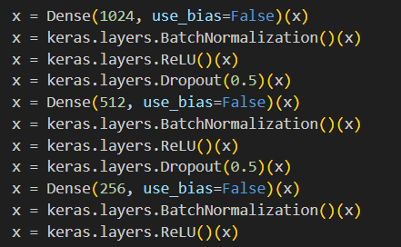
Improve learning curve
Dropout & Batch Normalization
We combined Batch Normalization and Dropout in order to further improve regularization, obtaining similar results as using both separately.
They give very similar accuracies, but we can see how the loss for the regularization techniques individually is much lower than without regularization.

Slide 15
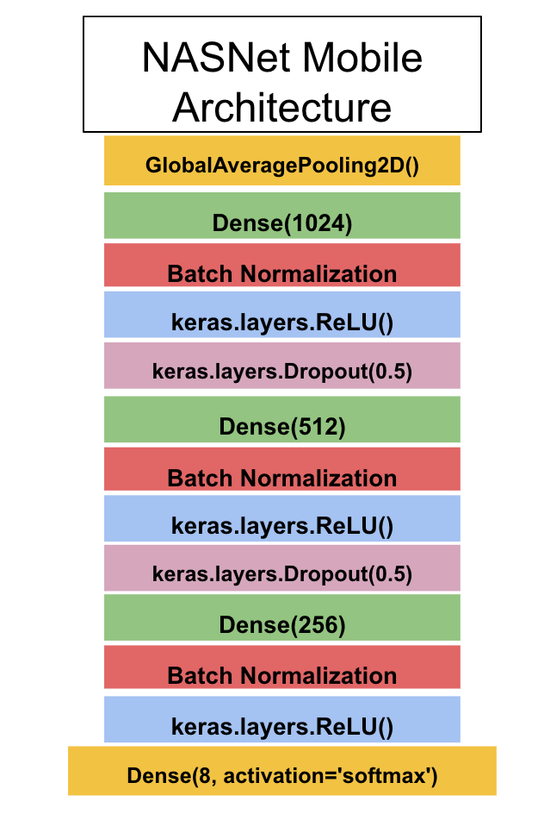
Final Model
<Best params>
Hidden layers: 3
Drop-out: 0.5
Batch size: 32
Num epochs: 20
Optimizer: ‘Adam’
No Data Augmentation
Final Accuracy: 88.4%

Slide 16
Week 4: CNN from scratch

Slide 17
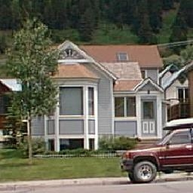
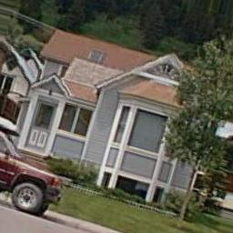
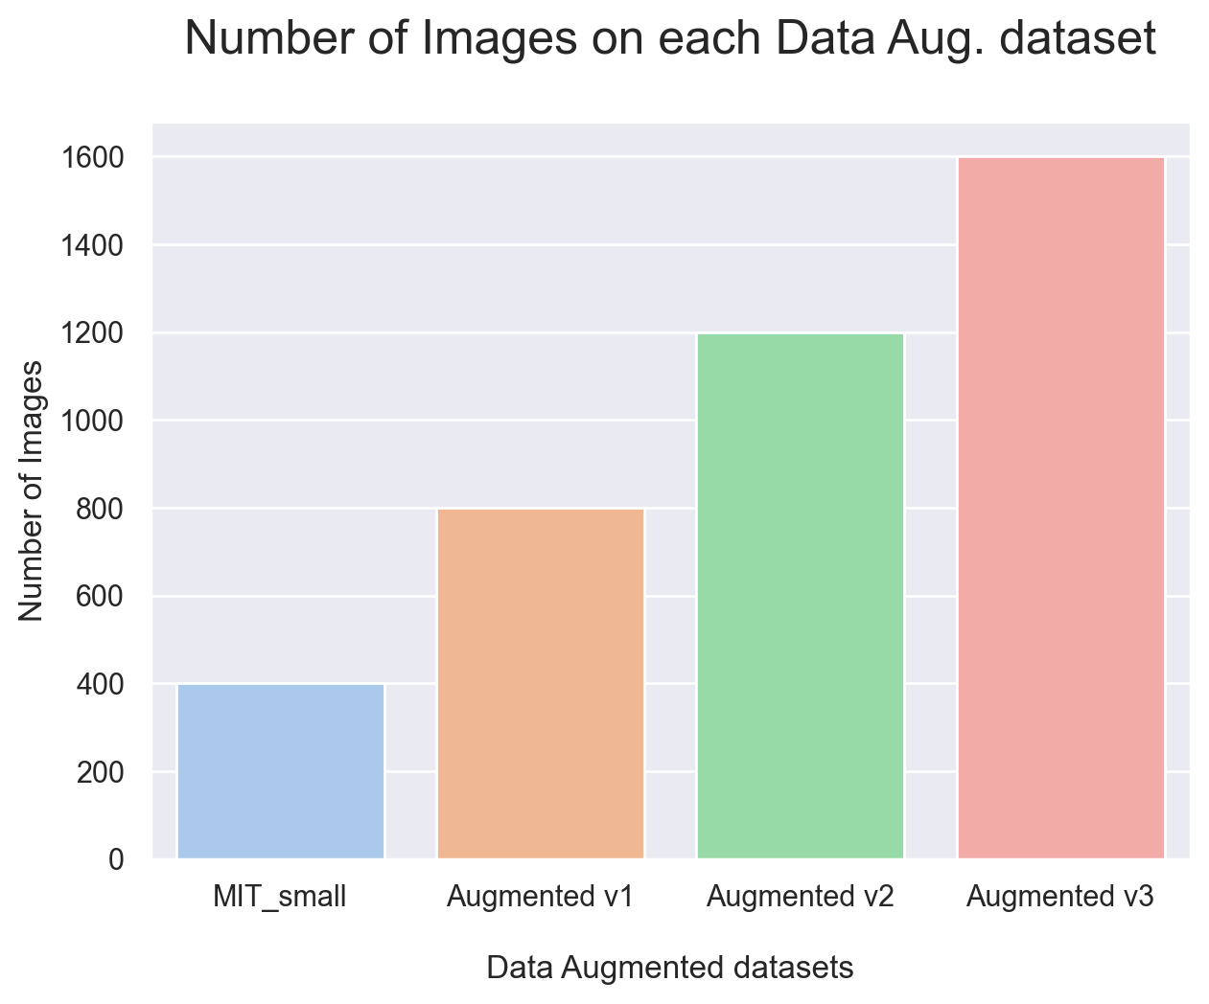
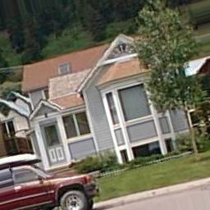
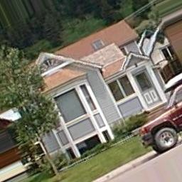
Data Augmentation (but well done)
In the previous weeks, the `tensorflow` data augmentation made the modification in place, meaning that it did not created new images but modified the existing ones. This week we have made such that the data augmentations were saved.
3 new datasets were created:
Mod. 1:
Original image
Rotation: 15º
Desp x : 0.1
Desp y : 0.1
Zoom : 0.9
H flip : True
Brightness = 0.9
Orig
+
Mod 1
+
Mod 2
+
Mod 3
Orig
+
Mod 1
+
Mod 2
Mod. 2:
Mod. 3:
Orig
+
Mod 1
Rotation: -15º
Desp x : 0.1
Desp y : 0.1
Zoom : 0.95
H flip : True
Brightness = 0.9
Rotation: 25º
Desp x : -0.1
Desp y : -0.1
Zoom : 0.95
H flip : False
Brightness = 1.1
Orig

Slide 18
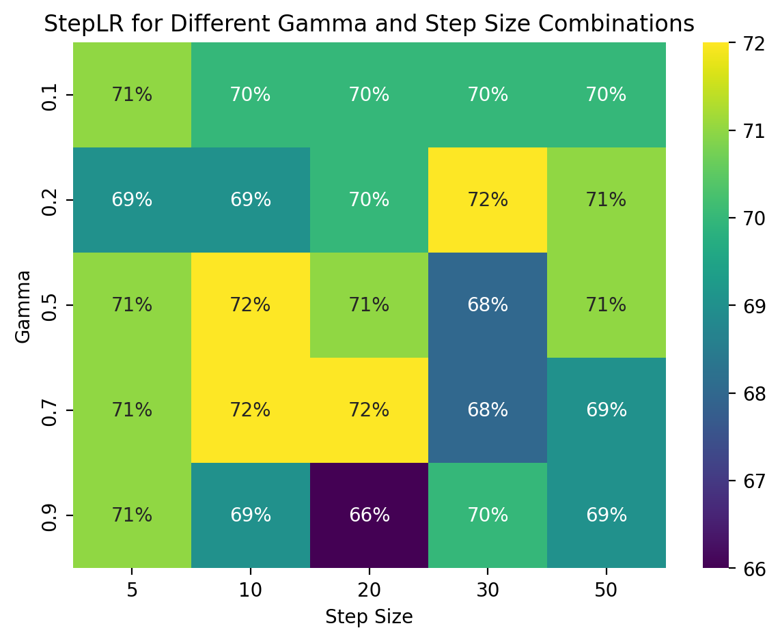
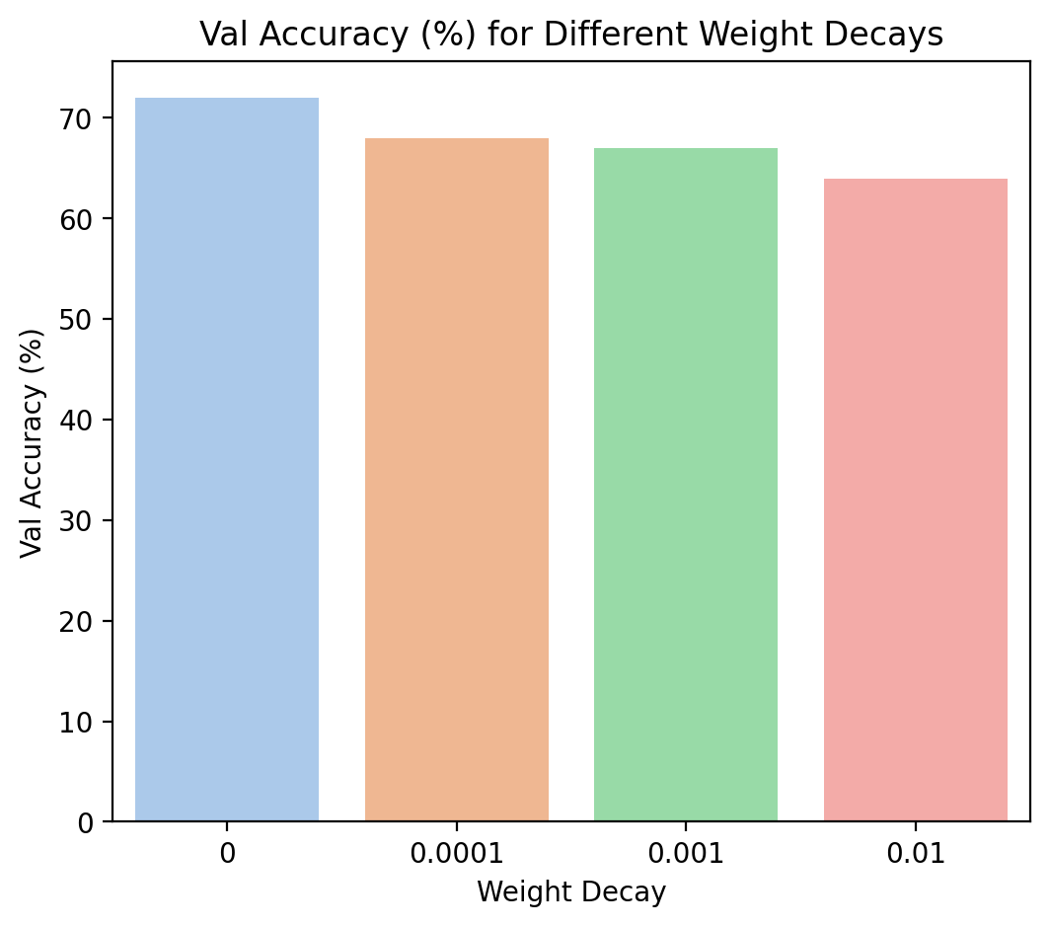
LR Scheduler
Weight Decay
We’ve tried an external `lr_scheduler` provided by PyTorch and the results were not conclusive.
Inside Adam, we’ve benchmarked different weight decay values, the results are not good either.

Slide 19
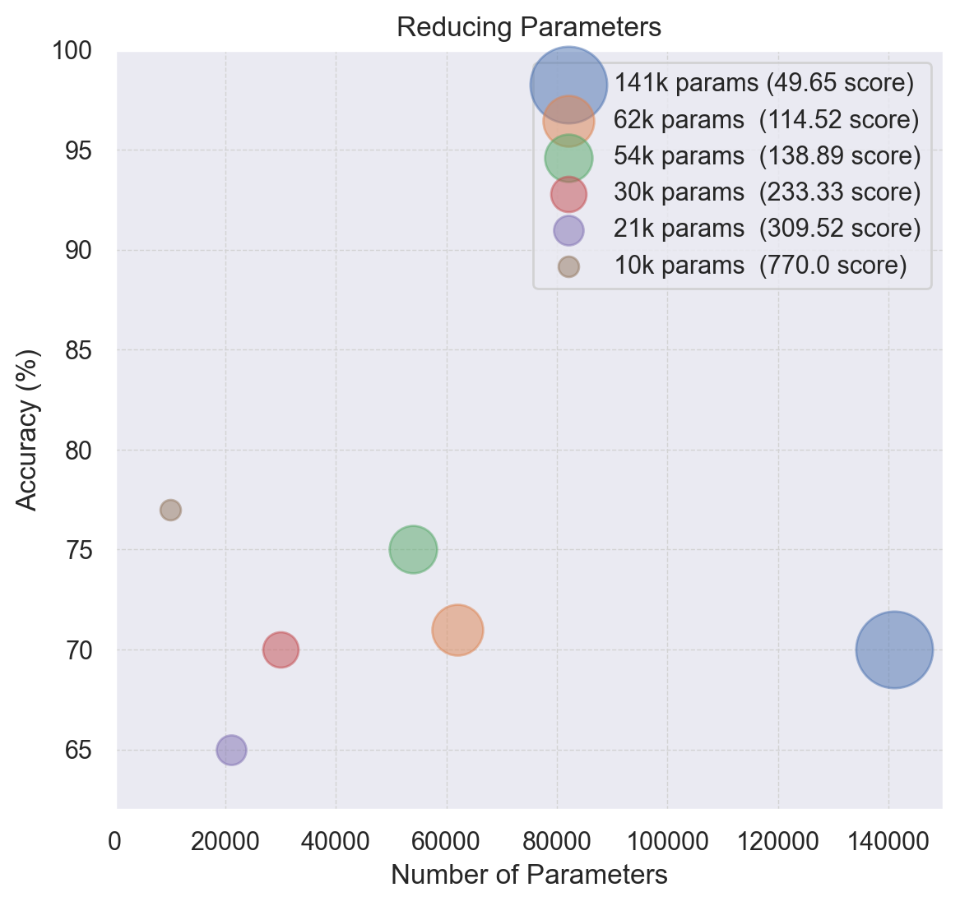
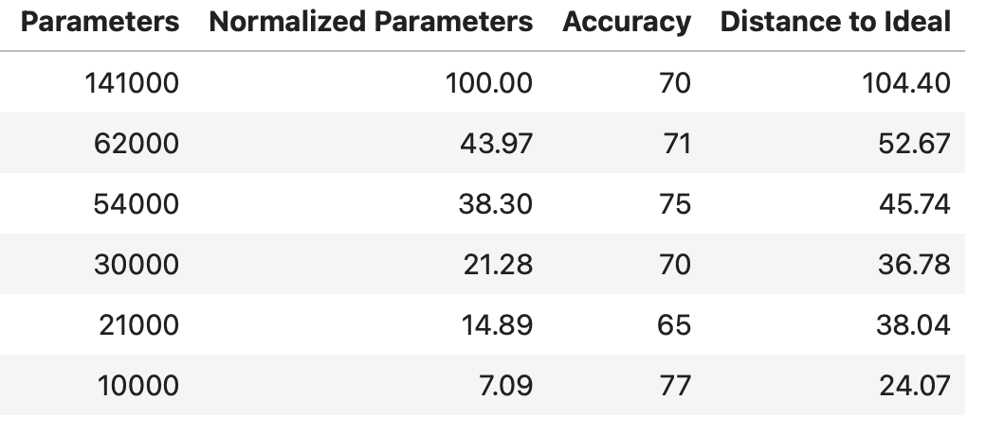
Reducing Parameters
As suggested, by the plot, we have to guide not only by the score but by the model distance to the ideal top-left corner (0, 100%) normalized:
Distance to Top-Left corner

Slide 20
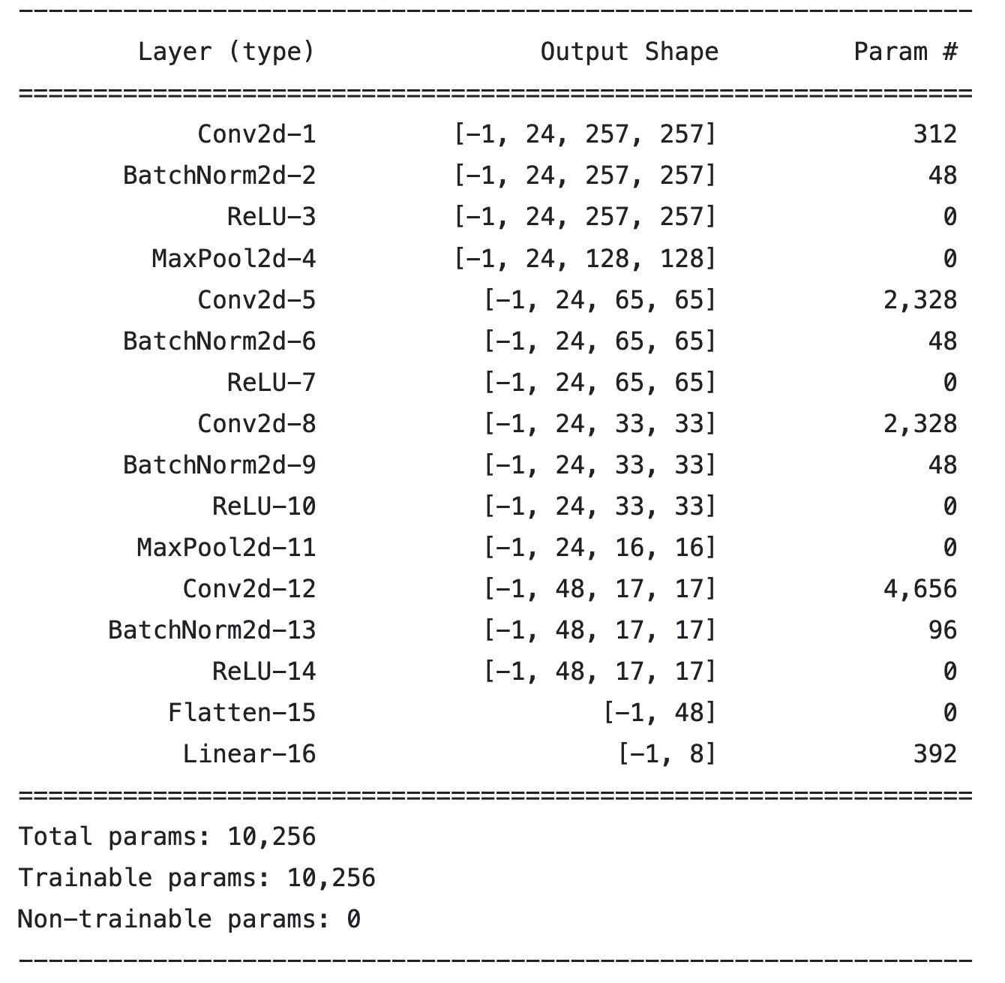
Used architecture
*
*
Conv
24, 2x2, 1, 1
Max Pool
2x2
Conv
24, 2x2, 1, 1
Conv
24, 2x2, 1, 1
Max Pool
2x2
Conv
24, 2x2, 1, 1
Test Acc: 77%
Global Average Pool
* Batch Normalization is used BEFORE every activation layer
(we observed it gave better results than using it afterwards)
Classification layer

Slide 21
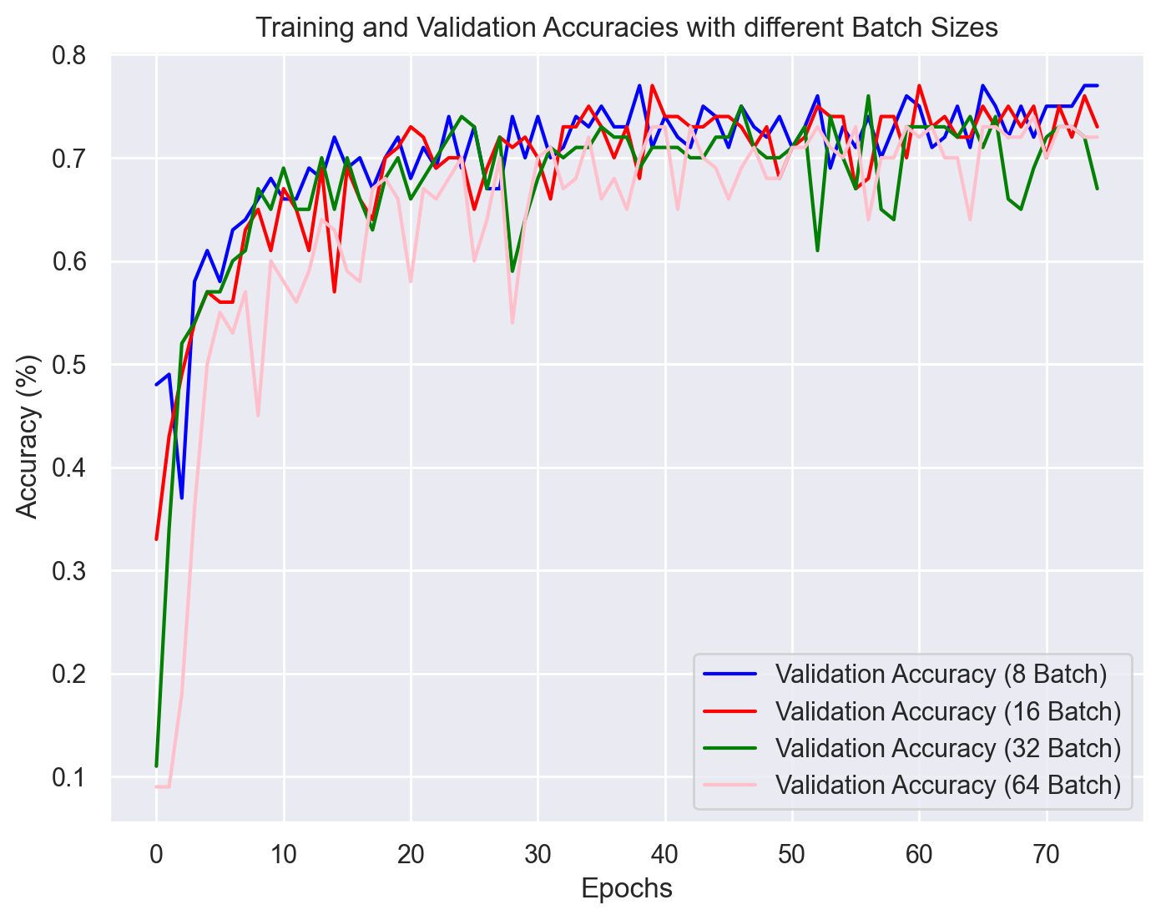
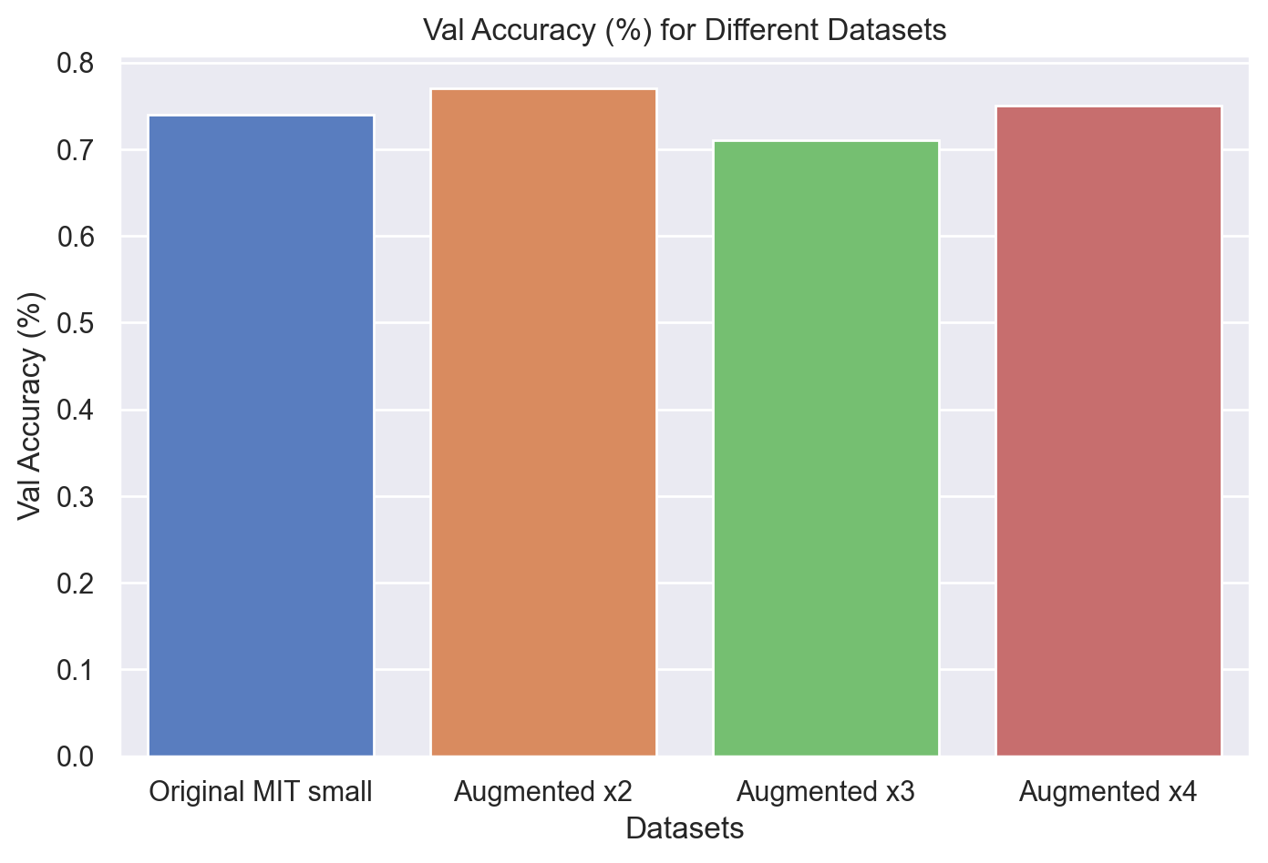
Batch size and Data @ 10k params model
Note that by reducing the Batch size we increase drastically the accuracy:
[8, 16, 32, 64]
Also, we note that using our augmented dataset of 800~ train images leads to the best results.
More train images than that produces severe overfitting:

Slide 22
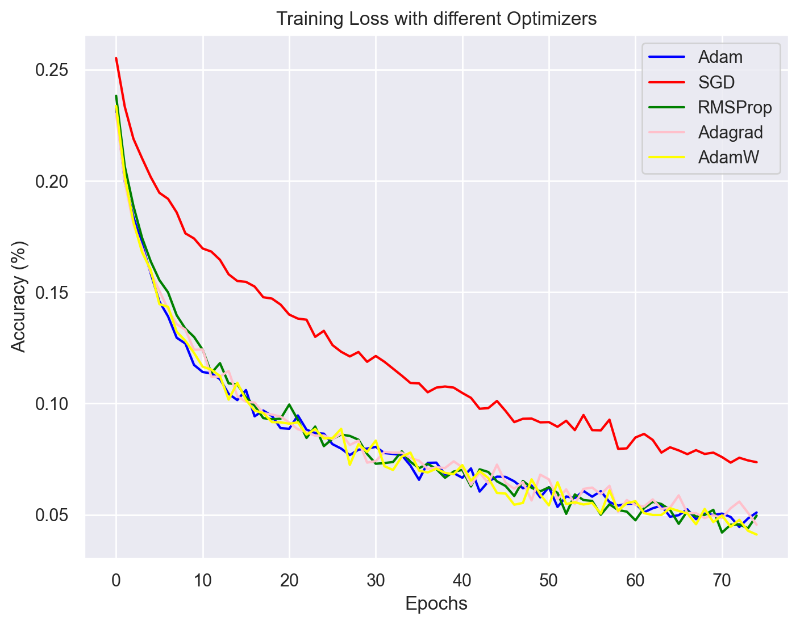
Different Optimizers @ 10k params model
We’ve tried different optimizers provided by PyTorch:
Adam
SGD
RMSProp
Adagrad
AdamW
As we can see, Adam and AdamW are much more stable through the process. Even though ~All perform the same.
SGD is not stable.

Slide 23
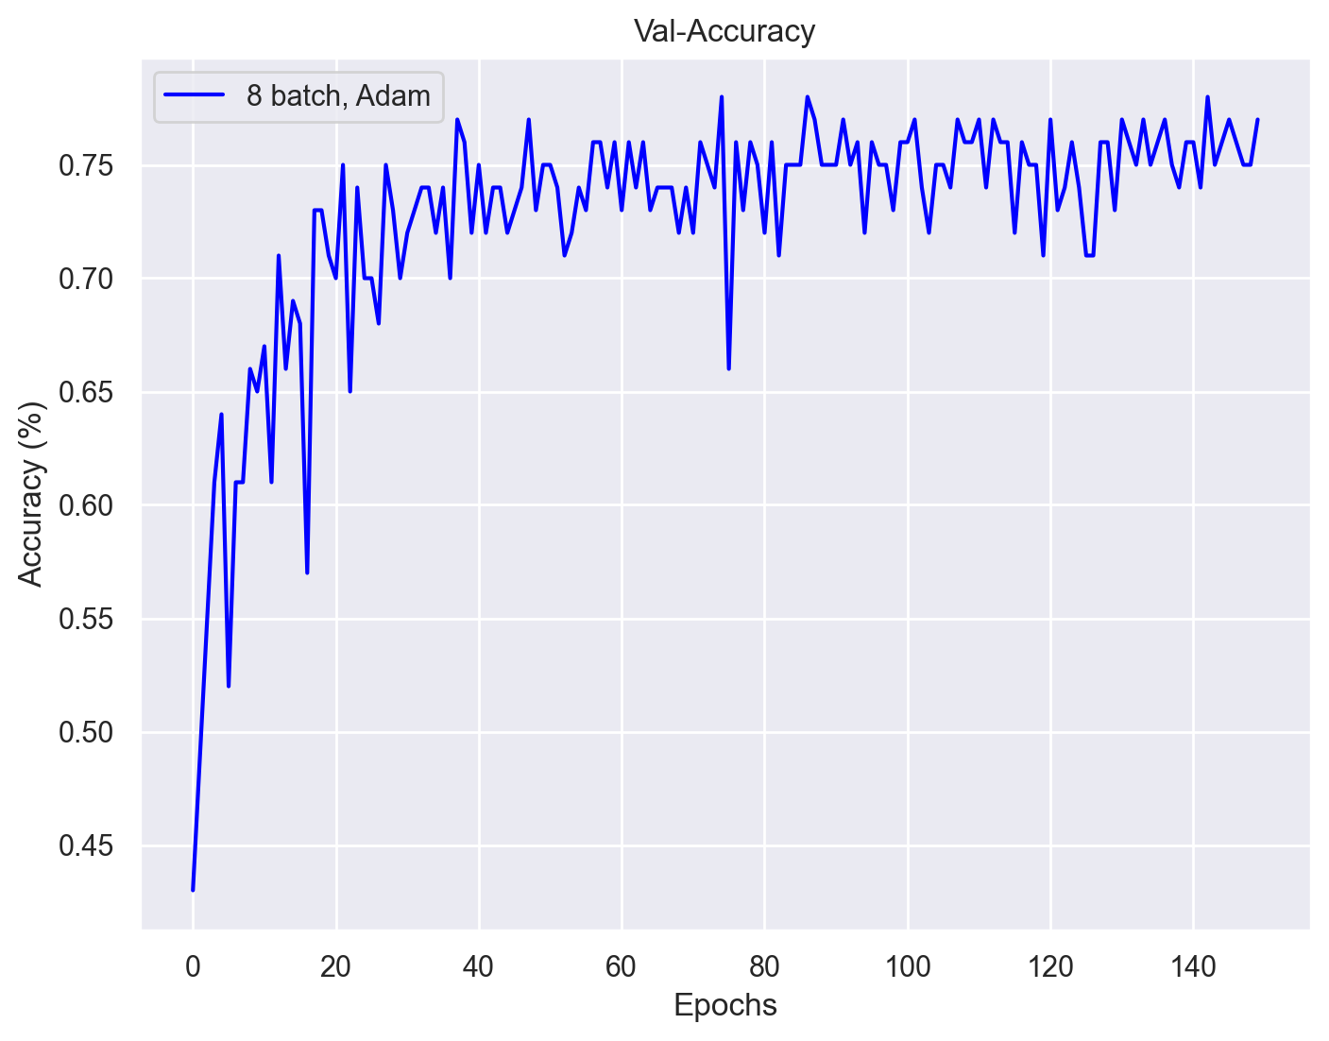
Improving Learning Curve @ 10k params model
Because we were doing good train accuracies but our validation was stuck we tried:
Increasing the epochs to 150 ✅
Using Adam’s Weight Decay
Bigger x4 dataset
Using He (ReLU) init.
77%

Slide 24
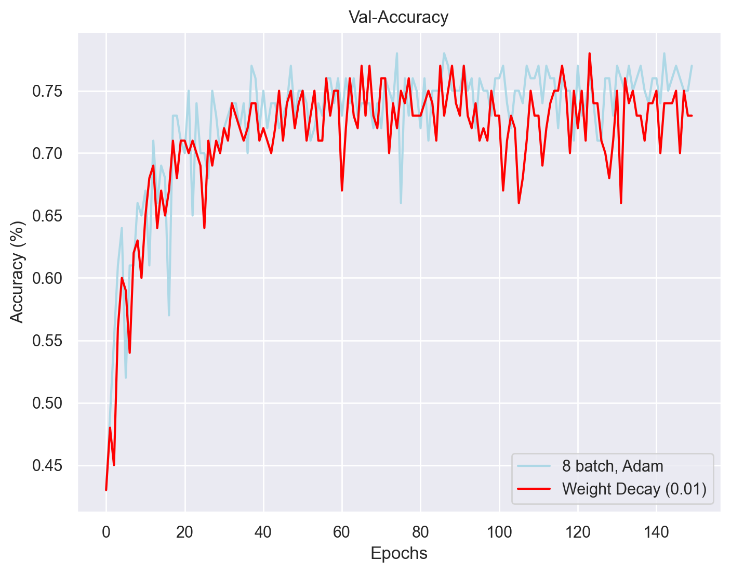
Improving Learning Curve @ 10k params model
Because we were doing good train accuracies but our validation was stuck we tried:
Increasing the epochs to 150 ✅
Using Adam’s Weight Decay ❌
Bigger x4 dataset
Using He (ReLU) init
73%

Slide 25
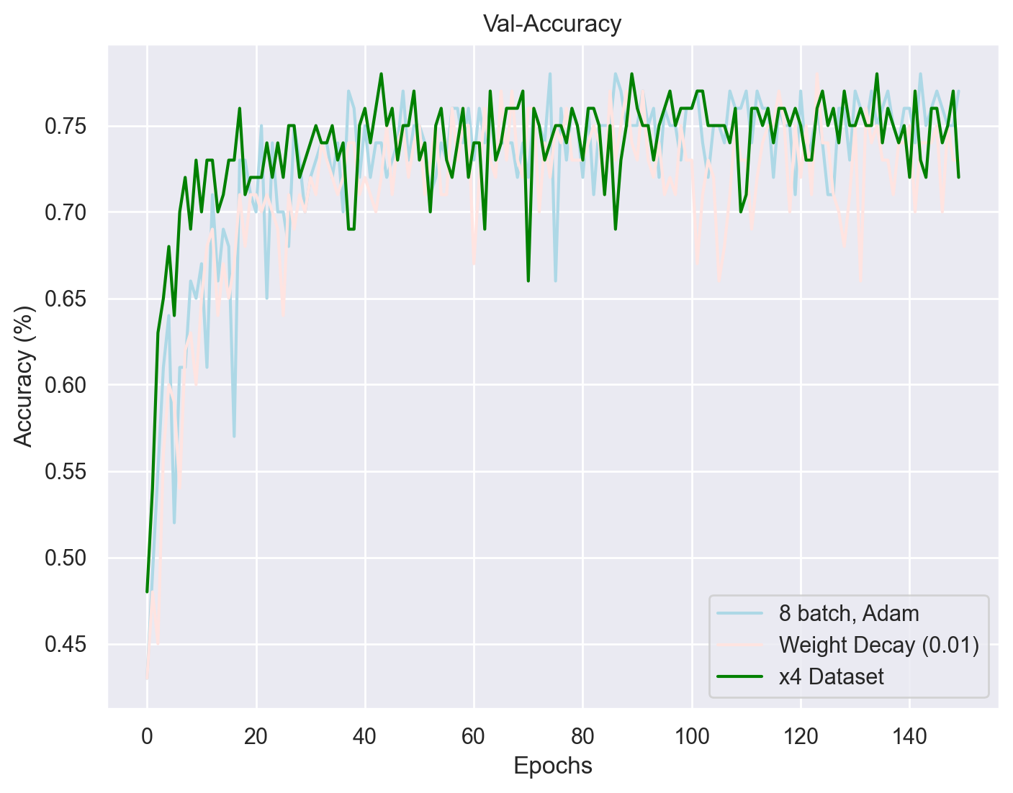
Improving Learning Curve @ 10k params model
Because we were doing good train accuracies but our validation was stuck we tried:
Increasing the epochs to 150 ✅
Using Adam’s Weight Decay ❌
Bigger x4 dataset ❌
Using He (ReLU) init.
72%

Slide 26
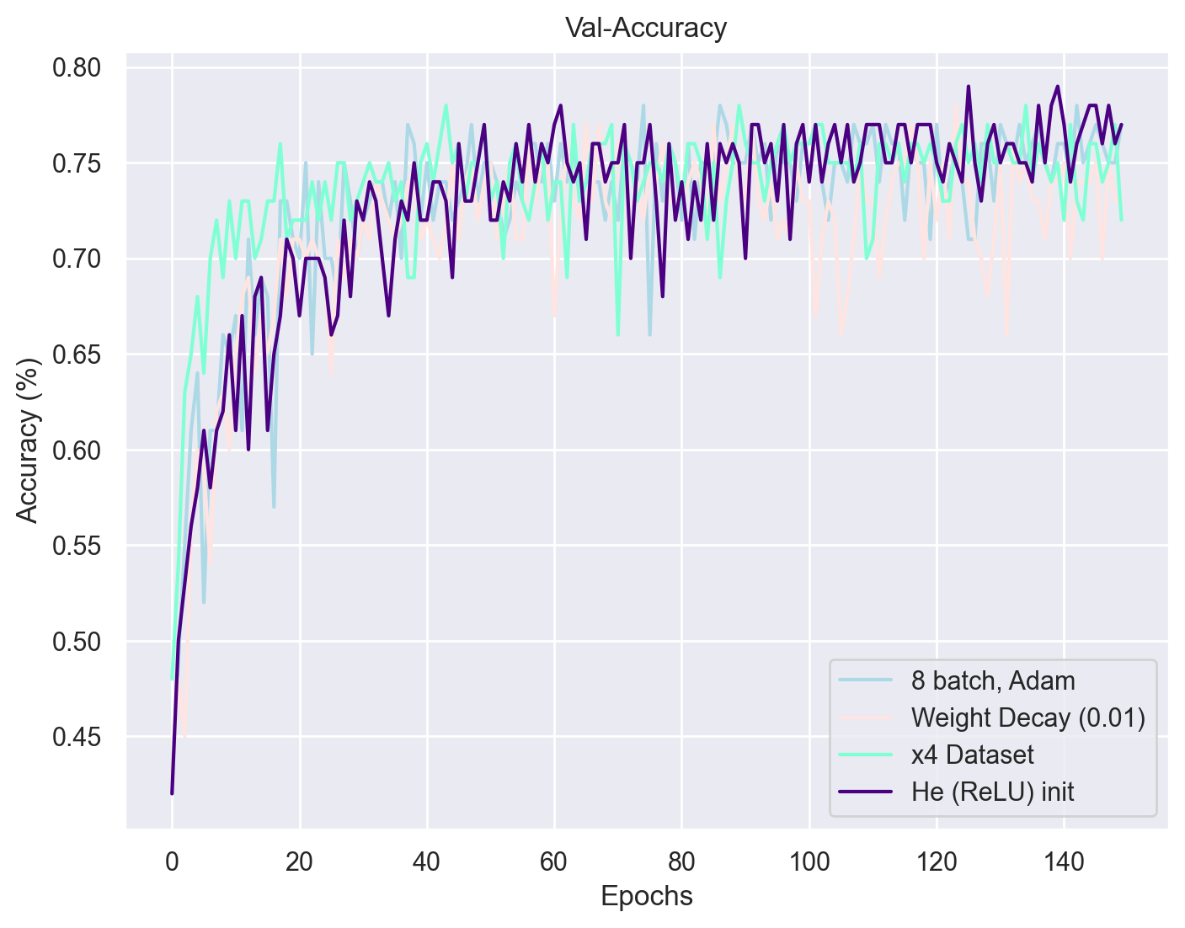
Improving Learning Curve @ 10k params model
Because we were doing good train accuracies but our validation was stuck we tried:
Increasing the epochs to 150 ✅
Using Adam’s Weight Decay ❌
Bigger x4 dataset ❌
Using He (ReLU) init. ✅
79%

Slide 27
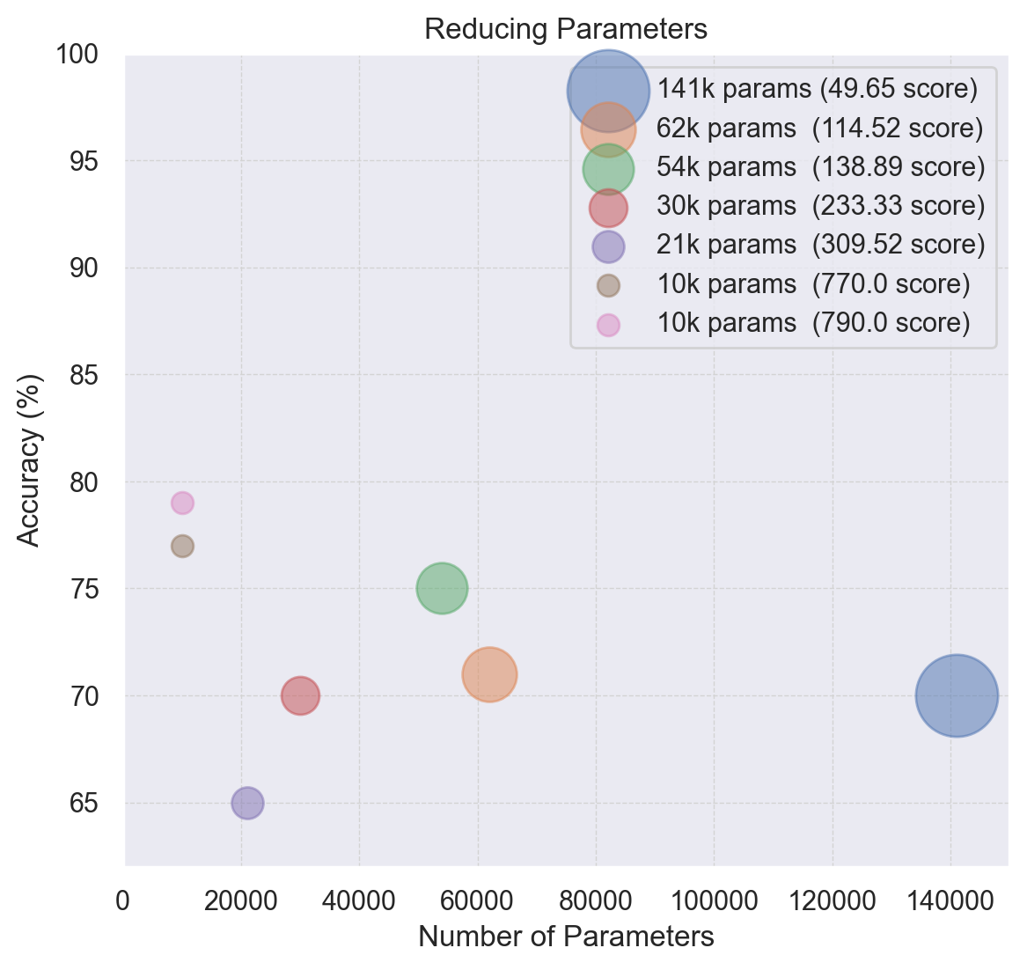
Improving Learning Curve @ 10k params model
10k params
8 batch size
Adam (without Weight Decay)
He Initialization
So much time and experiments for so little reward.
It was much more worth the time reducing parameters.

Slide 28
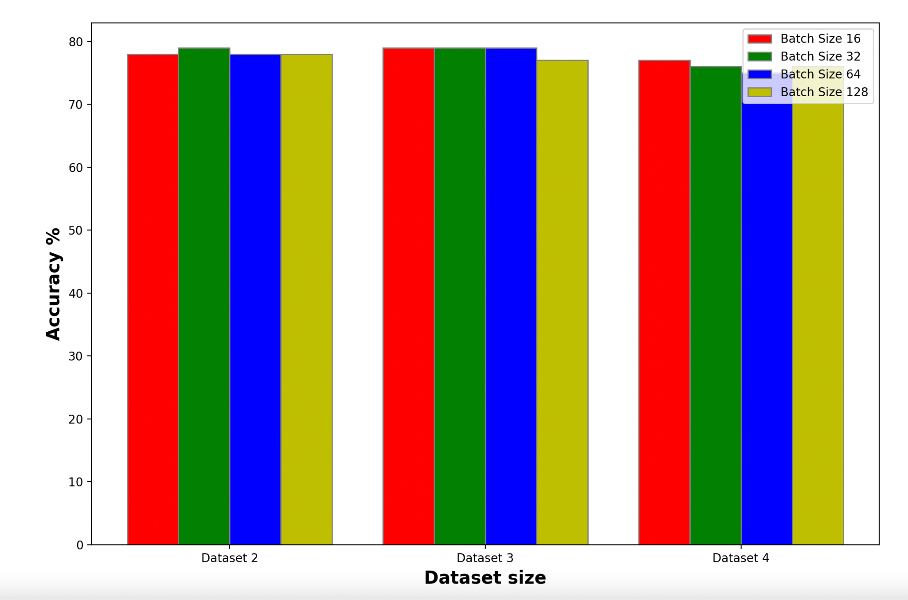
Change in model architecture: different paths
Concatenation of paths using different poolings and kernels. Analyzing different scales and combining the results.
Just 10k parameters and 79% of accuracy!!
Different datasets and batch sizes to find the best result
Conv
8, 5x5
Conv
16, 3x3
Glob. Avg. Pool
Max Pool
2x2
Glob. Avg. Pool
Max Pool 2x2
Conv
8, 5x5
Conv
16, 3x3
Classification layer
Conv
8, 9x9, 3
*
Max Pool
3x3
Glob. Avg. Pool
Conv
8, 5x5
Conv
16, 3x3
* Batch Normalization is used BEFORE every activation layer
(we observed it gave better results than using it afterwards)

Slide 29

Comments on the learning curve of one of the 3 path models
We can see the improvement of the model in every epoch, but it is not able to surpass 80% of accuracy.
The model overfits the used training set. Using data augmentation and other regularization techniques, such as Batch Normalization were not enough.
The main reason is the limited amount of training instances, since by using such a small dataset the model is not able to generalise correctly.
Still some
overfitting!

Slide 30

Conclusions
We have achieved a final score of 790 using two different approaches.
We dedicated much time to improve the learning curve when reducing the parameters was much more worth the trade-off.
Data is what really mandates in DL. The quality and quantity of the training set is tremendously important, specially when working with small datasets.
All in all, we were able to reach almost 80% accuracy on the test set with a very limited amount of data and using extremely few parameters.

